Slide 1
Data Needs for X-ray Astronomy Satellites
T. Kallman (NASA/GSFC)
Collaborators: M. Bautista (W. Mich.), A. Dorodnitsyn, M. Witthoeft (NASA/GSFC), J. Garcia (UMCP), E. Gatuzz (Ve), C. Mendoza (IVIC, Ve.), P. Palmeri (U. Mons, Belgium)

Slide 2
outline
About X-ray Astronomy
  Where we’ve come from
  Where we are
Atomic Data
  Tools
  Needs
Illustrative Applications of atomic data

Slide 3
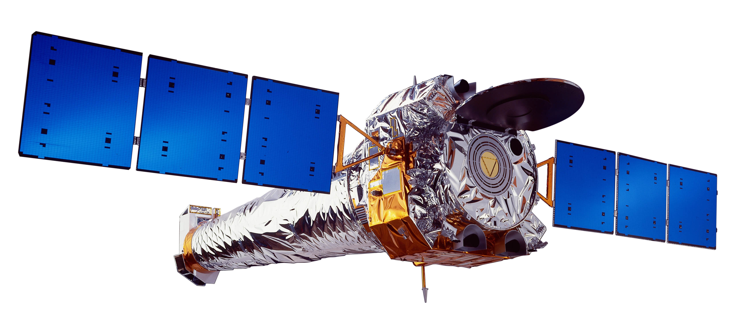
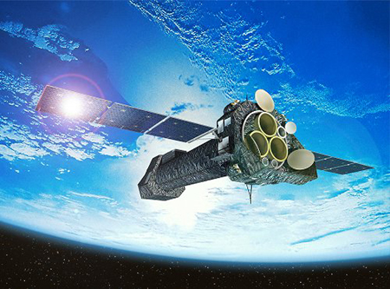
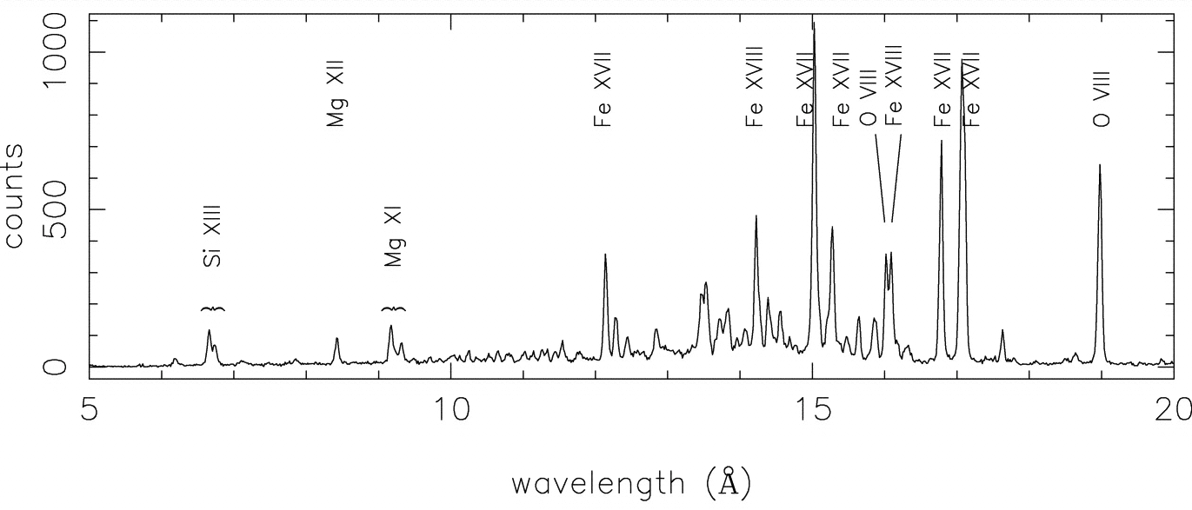
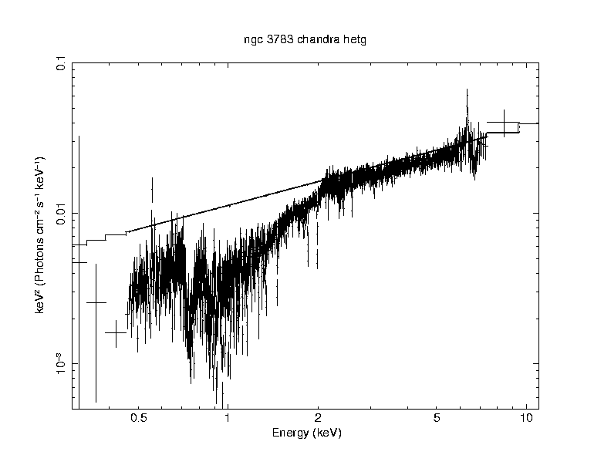
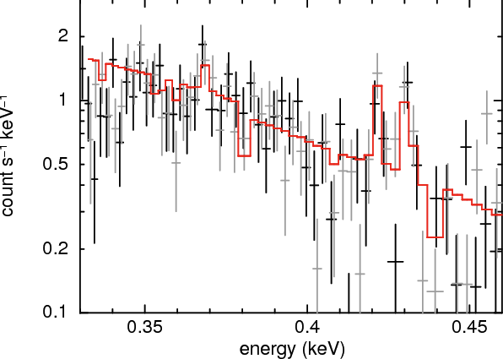
About X-ray Astronomy
  X-ray Astronomy is new:
  1960s: first measurements
  1980s: first large scale observations
  2000s: first spectra
  Photon numbers are key
  collecting area effectively limits spectral resolution
  Results depend on:
  model
  assumptions
  astrophysics
  statistics
  atomic data: comprehensiveness vs accuracy
  Objects of study include hot thermal or non-thermal sources, collapsed objects

Slide 4
ASCA data: coronal source

Slide 5
Chandra data: current model

Slide 6
Chandra data: 1980’s model

Slide 7
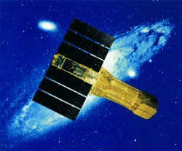
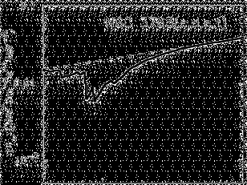
active galaxy spectrum: 1980s
1
10
Energy (keV)
(George et al., 1996)

Slide 8
active galaxy spectrum: 2001
spectra show many narrow absorption features
Features are all blueshifted
(Kaspi et al., 2002)

Slide 9
Current instruments have R<1000...

Slide 10
Atomic Data
X-ray sources differ from other astronomical sources:
likely to be non-lte
diversity of elements (but so far ~none with Z>30)
wide range of ion stages accessible to one observation
Needs:
comprehensive data (due to limited resolution)
nlte data: eg. electron impact collisions
data affecting inner shells
spectroscopic data with accuracy ~0.1%
We have come a long way
We owe a great deal to data producers
There is limited glory in this work, some funding

Slide 11
Atomic Data Sources
Experiment
Key for wavelengths
Validating calculations
Resonant processes (eg. Dielectronic recombination)
Calculation
Key for comprehensiveness
(relatively) new packages aid in this (autostructure, fac..)
Trends:
larger calculations possible due to parallelization
Importance of relativistic effects
resonance effects are important in many situations

Slide 12
Processes: Electron impact excitation (EIE)
e⁻ + X _{i} → X _{i}*
Leads to observable line emission via radiative decay
Modeling requires data for many transitions → calculations are key
Distorted wave (DW) remains workhorse for many purposes
Various tools are in use: autostructure, rmatrix, dw, hullac/fac, grasp/darc
Lab measurements are needed for accurate wavelengths and line IDs
Recent results:
Importance of damping
Size of CI calculation
Importance of relativistic effects
Needs
near-neutrals
inner shells
less abundant elements

Slide 13
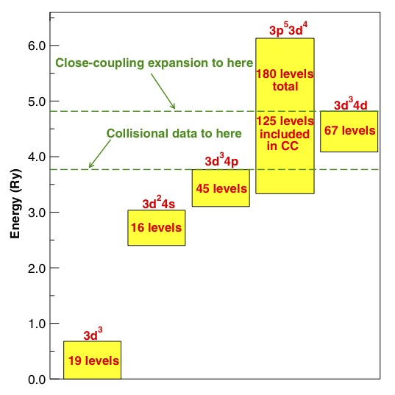
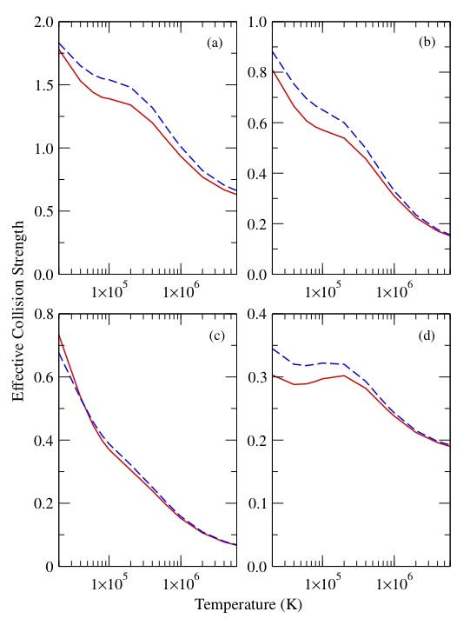
Effect of configuration interaction size in EIE
Dirac R-matrix (DARC) calculation of EIE in Fe⁵⁺
Ground is 3p⁶3d⁴
328 levels include 4s + one 3p⁵
1728 includes two 3p⁴ configurations
328 levels (dashed) vs. 1728 levels (solid)
Shows ~10% effects on upsilon
(Ballance and Griffin 2008 JPB 41 195205)
Notes:
13

Slide 14
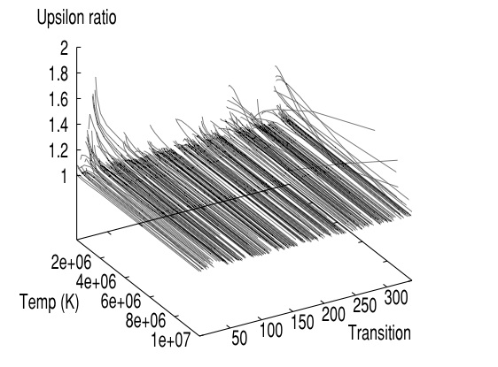
Relativistic effects in EIE
Dirac vs. BPRM for Fe ¹⁴⁺
Shows the level error associated with BPRM
Departures show at low temperatures, close to threshold
(Berrington et al.2005 JPB 38 1667)
Notes:
14

Slide 15
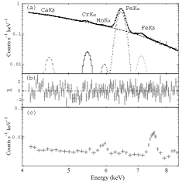
Suzaku spectrum of Tycho SNR
Detection of Cr, Mn Kα lines is very constraining to SNR models
Line energies (based on isoelectronic interpolation) → ~Na-like ions
Implies large NEI effects
Need for atomic data for EIE of Kα
(Tamagawa et al. 2009 PASJ 61 167)

Slide 16
Electron impact ionization (EII)
e⁻ + X _{i} → X _{i+1}
Important for many astrophysical problems
Quantity of data needed is limited → experiments can produce all or most
Many experiments, eg. ORNL
Compilations by Arnaud and Rothenflug → Dere, rev. by Bryans
  Motivated by distorted wave (DW) calculations
Experiments are affected by metastables, excitation-autoionization (EA)
Needs
  computations for excited states
  inner shells
  near threshold
  resonance processes, eg. reda

Slide 17
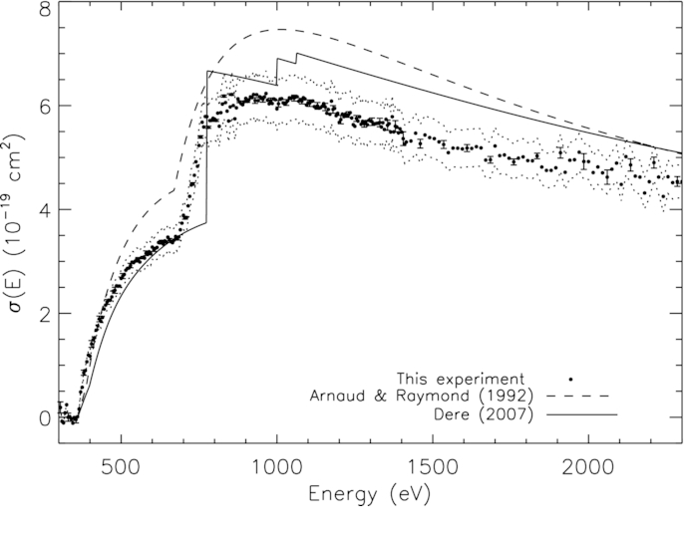
Measurements of EII with Heidelberg storage ring (TSR)
Fe ¹²⁺ → Fe ¹³⁺
Campaign to benchmark theory for all isosequences
Storage ring allows low metastable fraction
Compare with DW calculations
Hahn+ 2011 Ap J. 235 105

Slide 18
Dielectronic recombination (DR)
e⁻+X_{i} → X_{i-1}* → X_{i-1} +…
Traditional calculations are adequate for high temperature plasmas
Fundamental work by Burgess + compilations
At low temperature, calculations do not have sufficient precision
Experiments have proven to be crucial: TSR
Recent campaign by ADAS

Slide 19
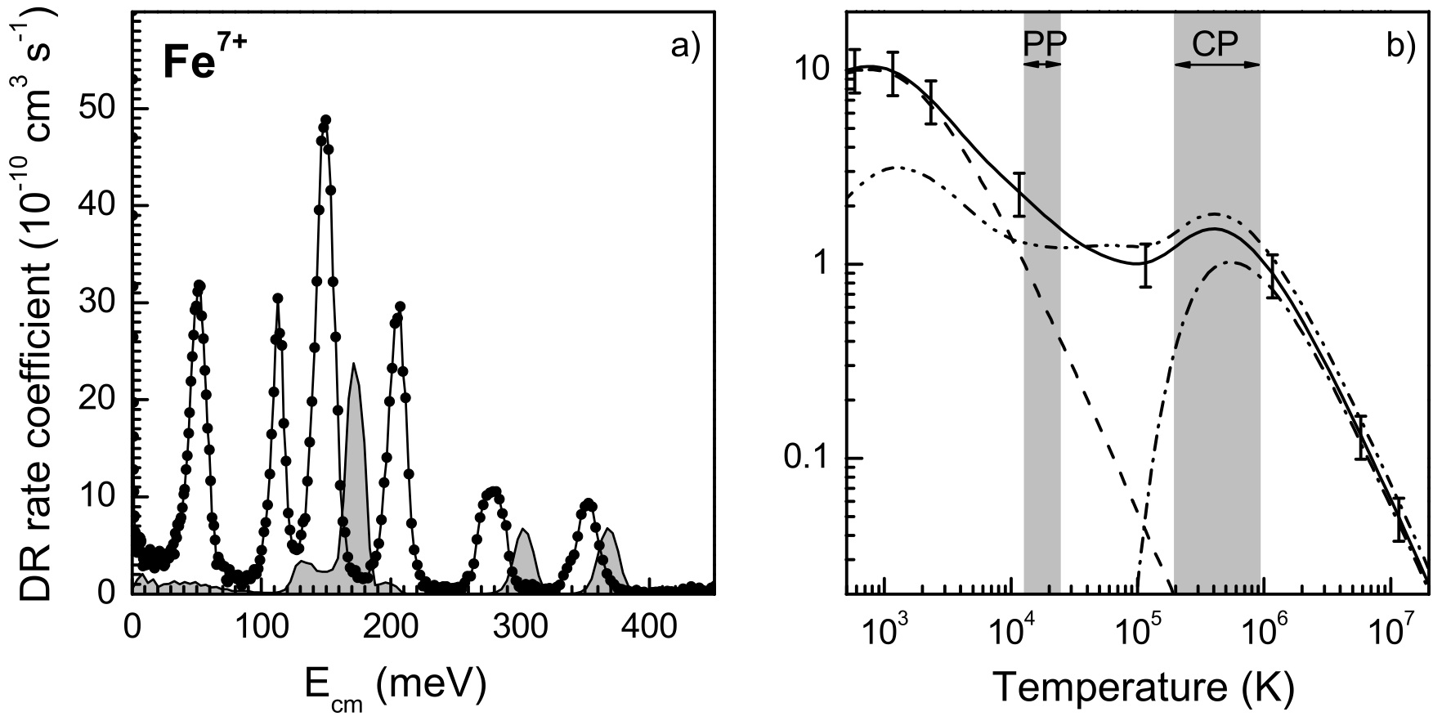
DR measurements using Heidelberg storage ring (TSR)
Measurements provide key validation for calculations
Low relative speed of ion, e⁻ allows measurements of near-threshold cross section
Measurements for Fe are being pushed to low charge
Have now measured DR for Fe⁷⁺ - Fe ¹⁰⁺ using TSR
(Schippers et al. 2010 Archiv:1002.35678)

Slide 20
Photoionization (PI)
hν + X _{i} → X _{i+1}
The rate coefficient (can) sample all parts of cross section
Campaign of calculations by opacity project (OP) +inner shells, intermediate coupling
High resolution experiments are coming
Needs:
    Neutrals/near neutrals
    Molecules
    Solids
    Lower abundance elements
    Spectroscopic accuracy
10/19/10

Slide 21
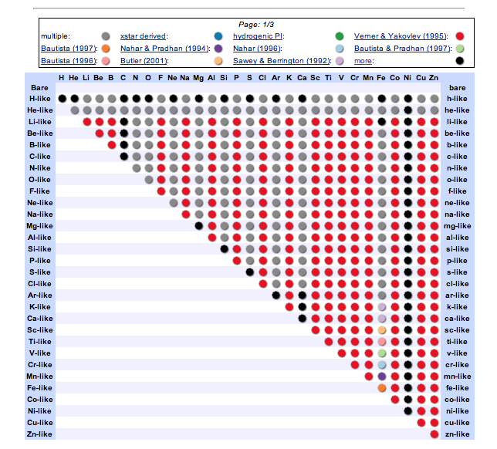
Availability of photoionization data

Slide 22
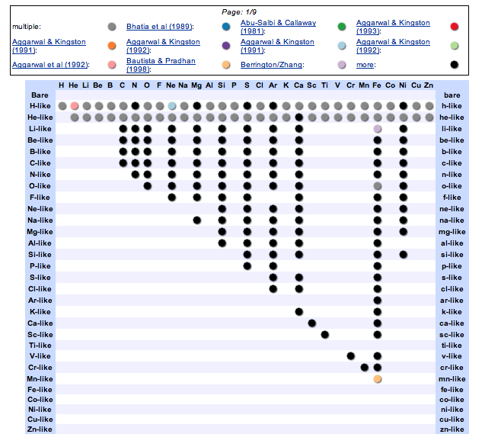
Availability of EIE data
http://heasarc.gsfc.nasa.gov/uadb/

Slide 23
Resonances appear in observed photoabsorption spectra
Spectrum of active galaxy MCG-6-30-15 shows 2nd KLL reonance near 20.1 A (19.9A lab)

Slide 24
BPRM Calculation of K shell Photoabsorption by oxygen
Black=bprm (Garcia+ 2005)
Green=central potential
(Verner and Yakovlev 1997)

Slide 25
K shell photoabsorption by neutrals
is in every astrophysical X-ray spectrum
Produced by atoms and ions in the interstellar medium
Neutral + few x ionized ions
Inner shells of abundant elements (C, N, O..)
Ubiquitous: N_{gal}~10²¹ cm⁻² ~1/σ_{PI}
X-ray observations can be used to measure:
ion fractions,
elemental abundances,
possible molecule/solid features
Plus, we expect molecules, solids → need accurate atomic cross sections to find them

Slide 26
Chandra observation of interstellar oxygen
From bright X-ray source XTE J1817-330
O⁶⁺ Kα
O⁺⁰ Kγ
O²⁺ Kα
O⁺⁰ Kδ
O⁰⁺ Kβ
O⁰⁺ Kα
O⁺ Kα
(Gatuzz+ 2012)

Slide 27
Theoretical and experimental cross sections for O, O⁺, O²⁺:
Without adjustment
With adjustment

Slide 28
Fit using adjusted bprm cross sectiions
Resonances up to Kδ are clearly detected
Observed and calculated resonance positions agree to within 33mA for O⁰, 79 mA for O⁺.
The available experiment also disagrees with the observation by 33mA.
This corresponds to ~450 km/s of Doppler shift, which is greater than is expected for galactic motion.
Abundance of O is consistent with solar
Ionization includes ~10% O⁺.

Slide 29
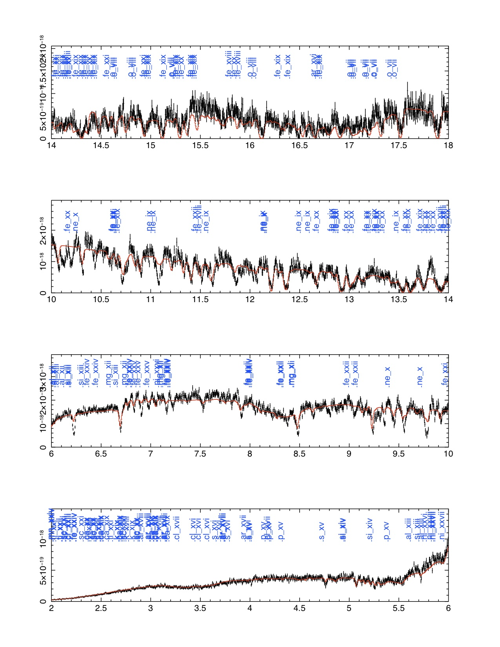
Photoabsorption spectrum of the active galaxy NGC 3783
The nucleus of this galaxy contains an accreting black hole
~130 Absorption features due to partially ionized O, Ne, Mg, Si, S, Ar, Ca, Fe
Absorption features are blueshifted by ~900 km s-1 → gas outflowing in wind
Model fits with χ²/ν~1.8
~2 components of gas needed

Slide 30
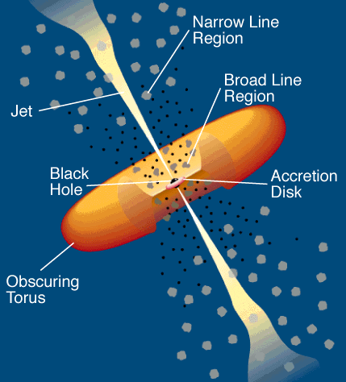
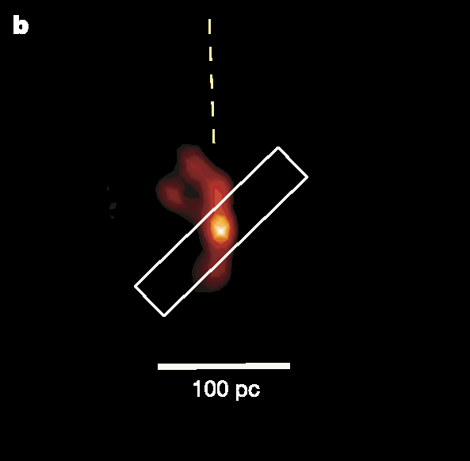
Active Galaxies are not round
Some show predominantly absorption features in X-ray spectra → we view the black hold directly through a warm wind (‘type 1’)
  Others show evidence for obscuration by dense material with column ~1 gm cm⁻²
  (‘type 2’)
  ‘Unified Model’
  By observing objects from different angles we can probe the 3d structure of the surroundings

Slide 31
X-ray spectra of type 2 objects show emission:
As predicted by unification, type 2 objects show scattered emission
Many of the same features are present in the spectrum
We can further test whether the conditions differ when viewed from different directions

Slide 32
Strongest lines include those from H- and He-like ions
Ne
O
Mg
Si

Slide 33
H- and He-like lines provide diagnostic information
Ratios of He-like resonance, intercombination and forbidden lines depend on density and excitation mechanism
R=f/I depends on density
G=(r+i)/r depends on temperature (coronal) or indicates continuum pumping (resonance scattering)
Ratio of He-like lines to H-like Lα provides measure of ionization (depends on ξ=4π radiation flux / gas density)
Observed ratios span a range 1<G<4, 2<He/H<4.5
values do not match with simple 1-zone collisional- radiative models
Self-shielding decreases effect of resonance scattering at high column densities
Models for finite slabs can be used to fit for ionization, column density (ξ,N)

Slide 34
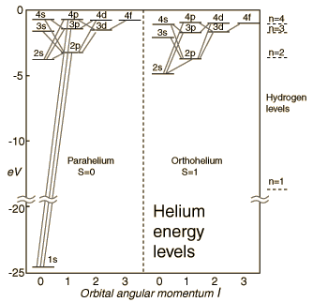
Helium Energy Diagram
.
R
F
I

Slide 35
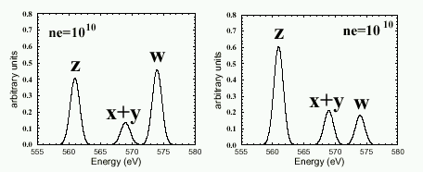
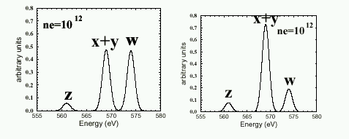
Density dependence of He-like lines
R I F
R I F
Coronal/scattering recombining
(Porquet and Dubau 1998)

Slide 36
Theoretical R and G ratios
  R=f/I → density
  G=(f+i)/r → temperature/excitation
Hhe=(f+i+r)/Lα → ionization
(Bautista+2000)

Slide 37
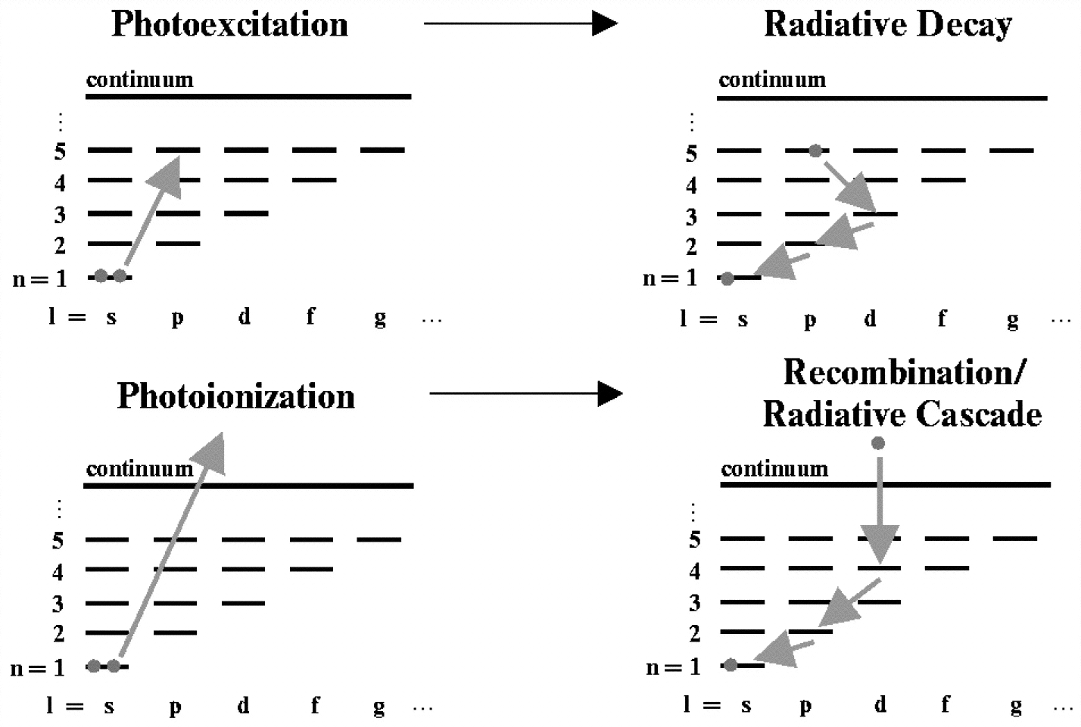
Scattering vs. recombination
Scattering refers to bound-bound resonant excitation
Recombination occurs after bound-free photoionization

Slide 38
Observed ratios: G, R, He/H
R ratios all indicate low density
G ratios Separate broadly into 2 groups:
  Ne and O at → larger G
  Si, Mg at smaller G
Models for pure recombination or scattering are outside observed range

Slide 39
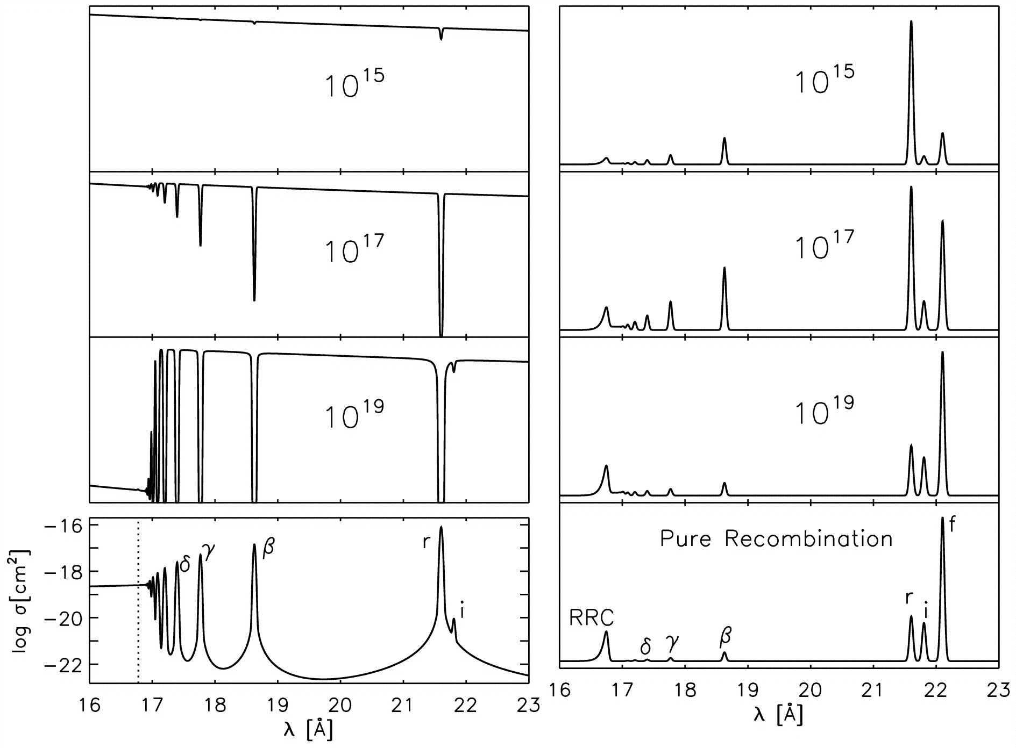
Scattering vs. recombination: effect of column density
O VII spectrum
Scattering wins at low columns
Makes strong allowed lines
Recombination wins at high columns
Makes recombination continua, forbidden lines emitted following cascade
Column density diagnostic
absorption
emission
(Kinkhabwala+ 2003)

Slide 40
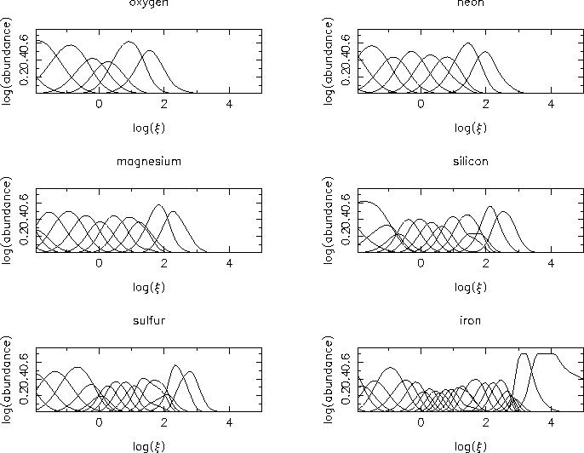
Modeling H- and He-like lines: ionization balance
ξ=‘ionization parameter’
=4π radiation flux / gas density

Slide 41
The effect of column density on G and He/H
Ionization
parameter
Column →

Slide 42
Column and ionization parameter inferred from H,He-like lines differs according to element
element | Log(ξ) | Log(column density) | Log(gas density)
O | 1.2 | 22. | <10
Ne | 1.6 | 22. | <11
Mg | 2.2 | 20.5 | <12
Si | 2.3 | 21. | <12.5
S | 2.6 | - | -
→ Consistent with a range of densities all at ~100 pc from the black hole

Slide 43
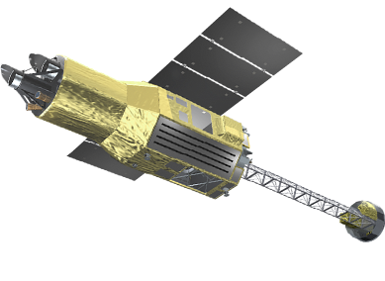
Summary
Atomic data is key for understanding X-ray spectra
X-ray spectra are providing insights not accessible to other techniques, key for understanding exotic processes, collapsed objects, physics under extreme conditions
A great deal of progress has been made in producing and accumulating data for this purpose
Important gaps remain:
inner shells
near neutrals
less abundant elements
The (near) future of X-ray astronomy emphasizes the 5-10 keV energy range

Slide 44
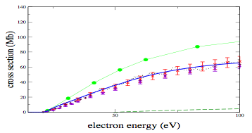
DW overestimates EII for low charge states
EII of Ne⁰
DW (green) +expt + RMPS (blue)
10/19/10
(Ballance et al. 2009 JPB 42 175202)

