Slide 1
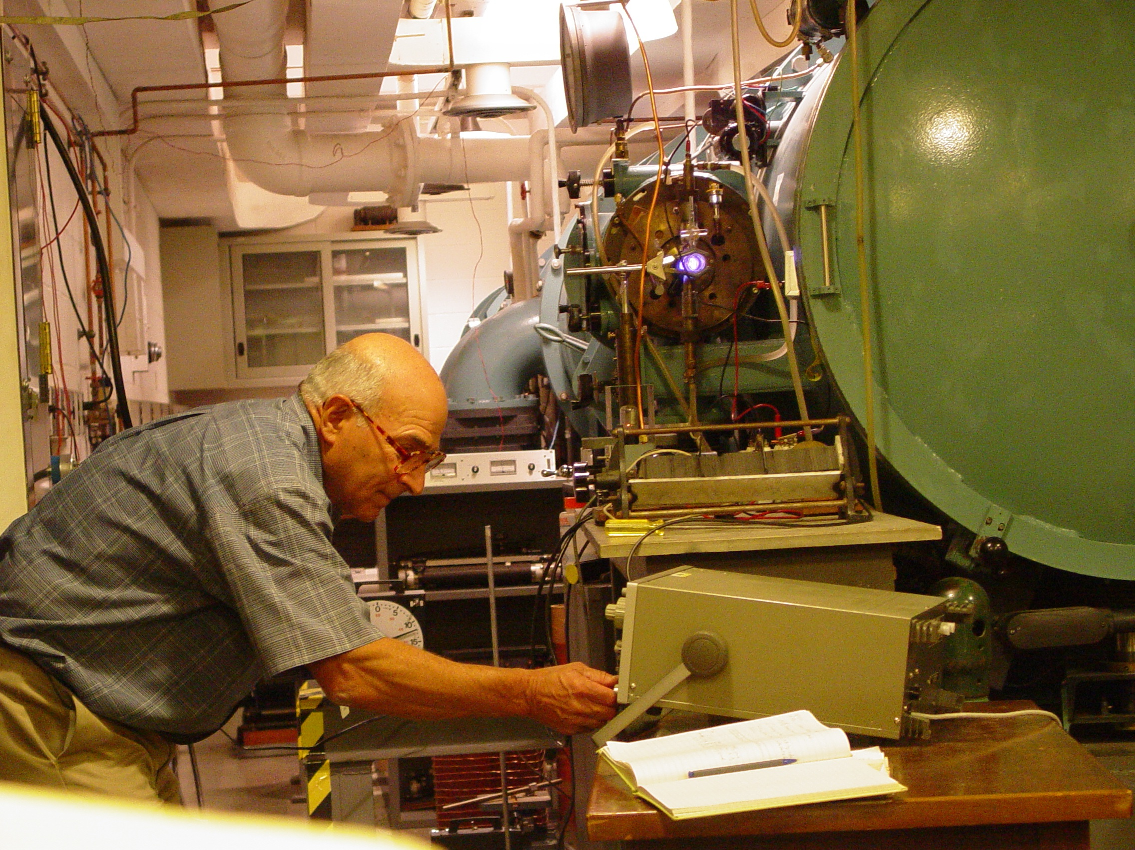
Laboratory Spectroscopy, Space Astrophysics and Fusion
A Tribute to Joe Reader and Friends
Notes:
At the 10.7m normal incidence vacuum spectrograph at NIST

Slide 2
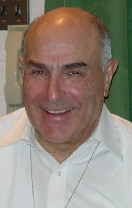
Joe Reader: Career Mileposts
B.S., Purdue University, 1956 – Fellow Boilermaker!
M.S., Purdue University, 1957
Ph.D., University of California, Berkeley, 1962
Research Associate, Argonne National Laboratory, 1962 – 1963
Physicist, NIST, 1963 – present
Group Leader, NIST Atomic Spectroscopy Group, 2000 – 2008
Director, Atomic Spectroscopy Data Center, 2008 – present
Senior Advisor to Atomic Spectroscopy Group, 2008 – present
NIST Fellow, 2010 - present
Author of ~ 180 scientific publications
Joe’s research spans the Periodic Table
from HI/DI, K⁺ and Mg⁺⁺ to Bi¹⁵⁺and U⁶³⁺ !

Slide 3
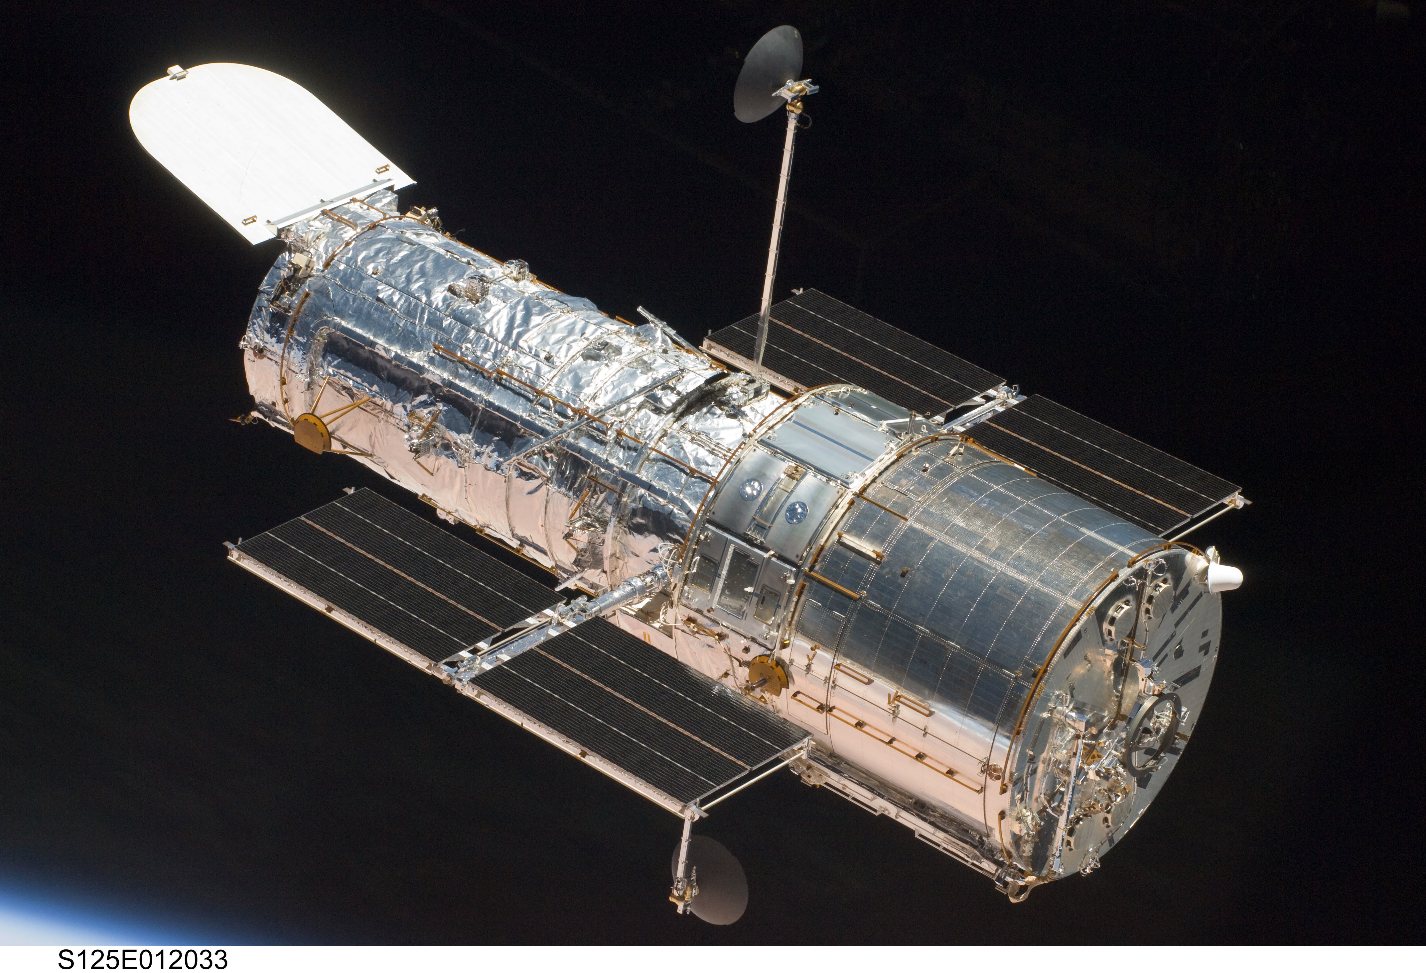
Great Scientific Facilities Joe Reader and His Team Have Supported
Chandra Space Telescope
Hubble Space Telescope
Tokamak Fusion Reactors

Slide 4
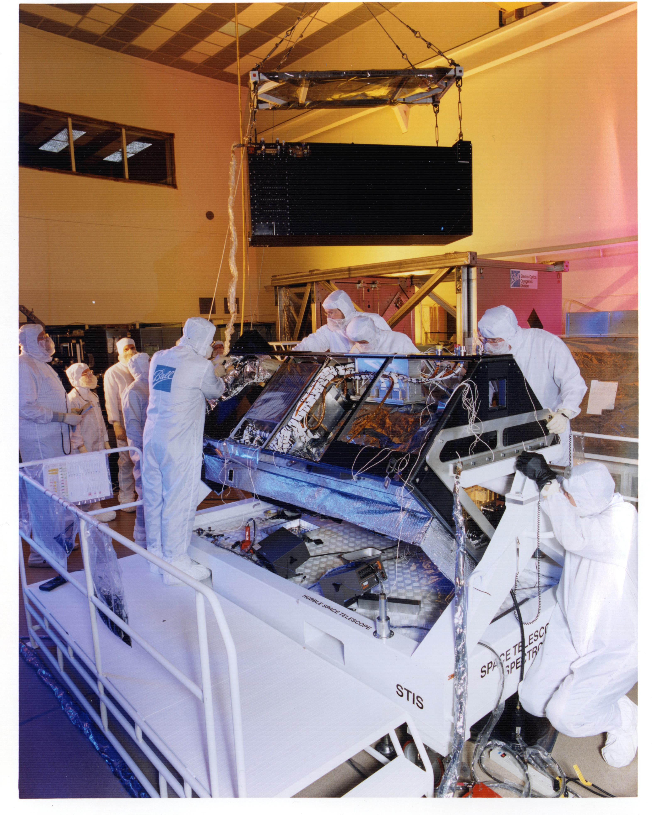
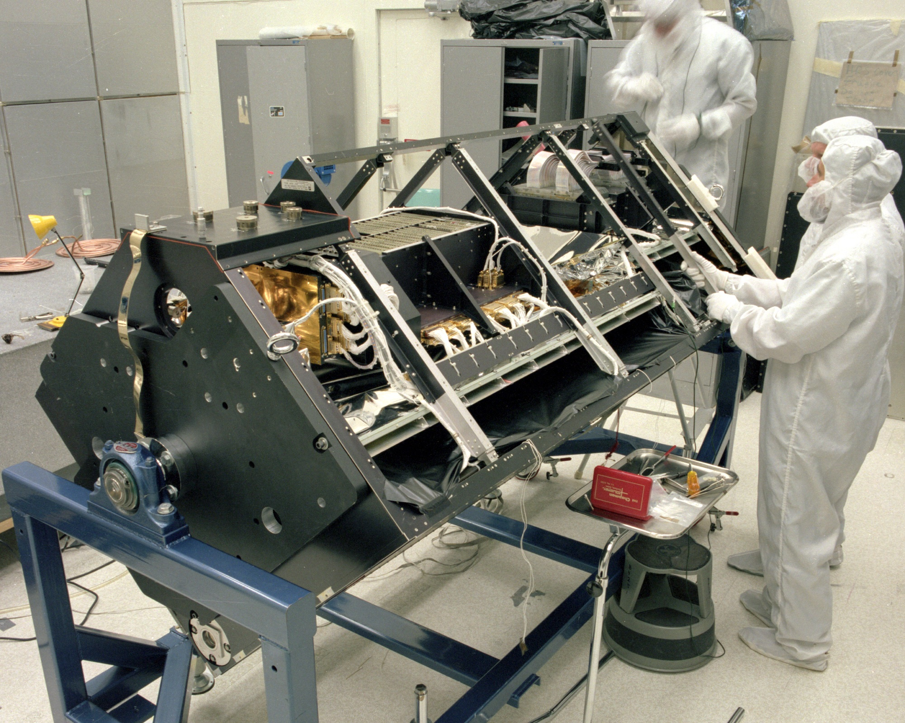
Hubble Space Telescope High Resolution Spectrographs Being Assembled at Ball Aerospace
Goddard High Resolution Spectrograph Launched in 1990 and Returned from Orbit in 1997
Space Telescope Imaging Spectrograph Launched in 1997, Repaired in Orbit in 2009, Still Operating in 2012

Slide 5
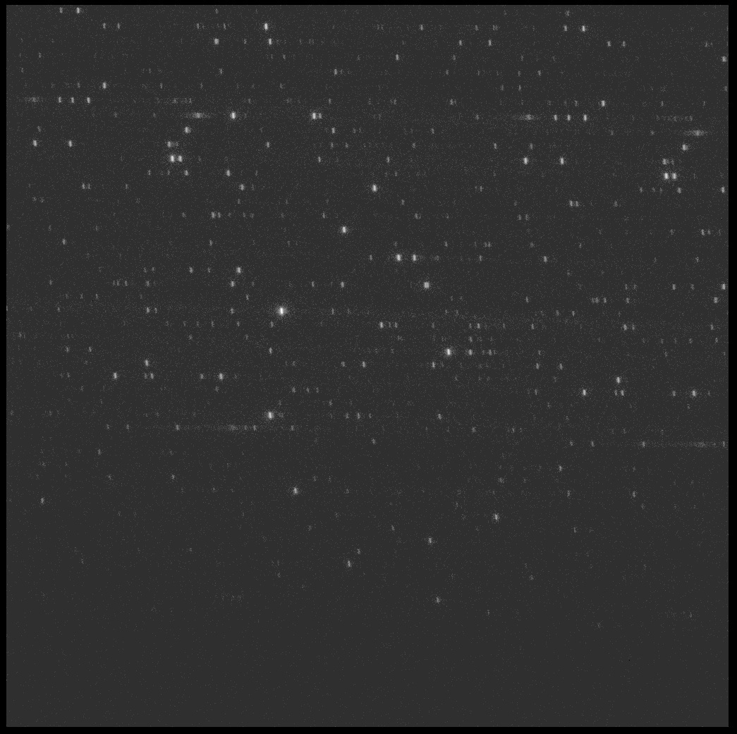
Pt-Ne Hollow Cathode Wavelength Calibration Lamp in the
Space Telescope Imaging Spectrograph on Hubble Space Telescope
Echelle Spectrum of Pt-Ne Lamp
Wavelength Map of Pt Spectrum Based on NIST Observations with 10.7m Normal Incidence Vacuum Spectrograph

Slide 6
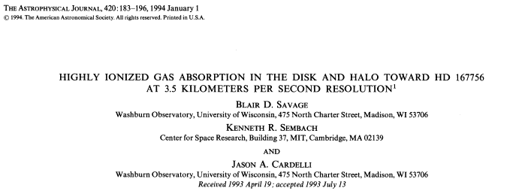
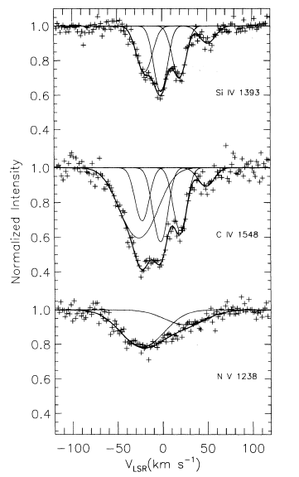
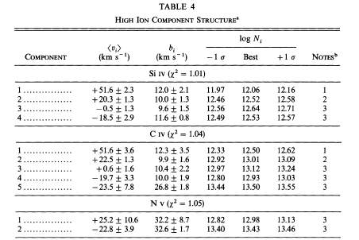

Slide 7
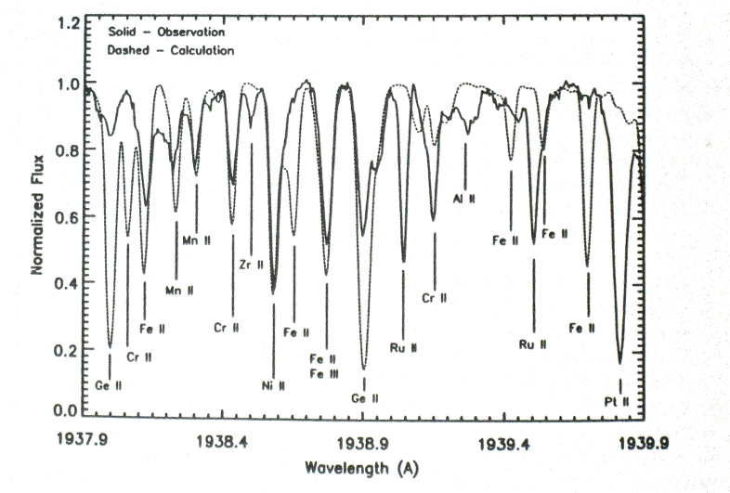
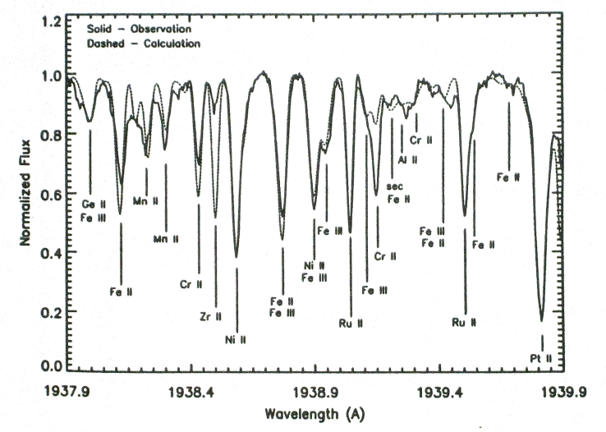
“We face the bleak prospect of attempting to analyze spectra of 1% precision, obtained at great expense, with atomic parameters that can be inaccurate by factors of 2 or 10, if they exist at all. The GHRS [on HST] will be relentless in highlighting this problem.”
From Leckrone, et al. 1989, High Resolution Ultraviolet Spectroscopy from Space Observatories: What Atomic Physics and Astrophysics Can Do for Each Other, ASOS3, Amsterdam
Synthesis of χ Lupi Spectrum (B-Peculiar Hg/Pt-Rich Star)
Before (Cowan Code log gf’s)
After (Updated Atomic Data)

Slide 8
Major Contributions of Joe Reader’s Atomic Spectroscopy Group to HST Very High Resolution UV Spectroscopy
Enabling Quantitative Studies of the Interstellar Medium and the Abundances of the Elements in Stellar Atmospheres
High precision atlas of lines from Pt/Ne calibration lamps; analysis of Pt II energy levels
Spectra of isolated isotopes of Hg I, Hg II and Hg III; derivation of Hg II and Hg III oscillator strengths
Spectra and oscillator strengths for Gd III and Eu III; energy levels and line identifications for Dy III
Spectra of Zr II and Zr III; energy level analysis and Ritz wavelengths for large number of lines
Spectra of Bi I, Bi II and Bi III; hyperfine structure patterns in lines of Bi II and Bi III
Spectrum of Pb III; measurement of isolated ²⁰⁴Pb III

Slide 9
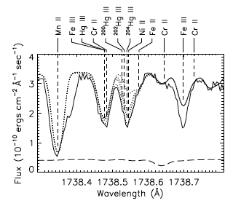
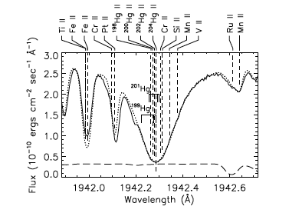
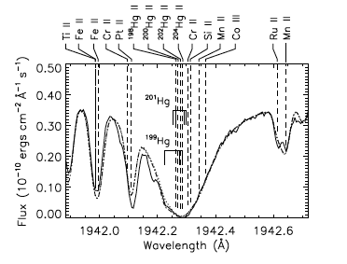
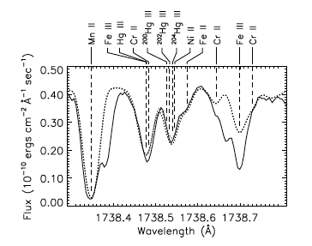
Observed Hg II and Hg III Lines Synthesized with Isotope Shifts and hfs Measured at NIST
Χ Lupi
99% ²⁰⁴Hg
~ 10⁵ Solar
HR 7775
66% ²⁰⁴Hg
27% ²⁰²Hg
~ 10⁵ Solar
From Proffitt, et al.,1999, ApJ, 512:942-960

Slide 10
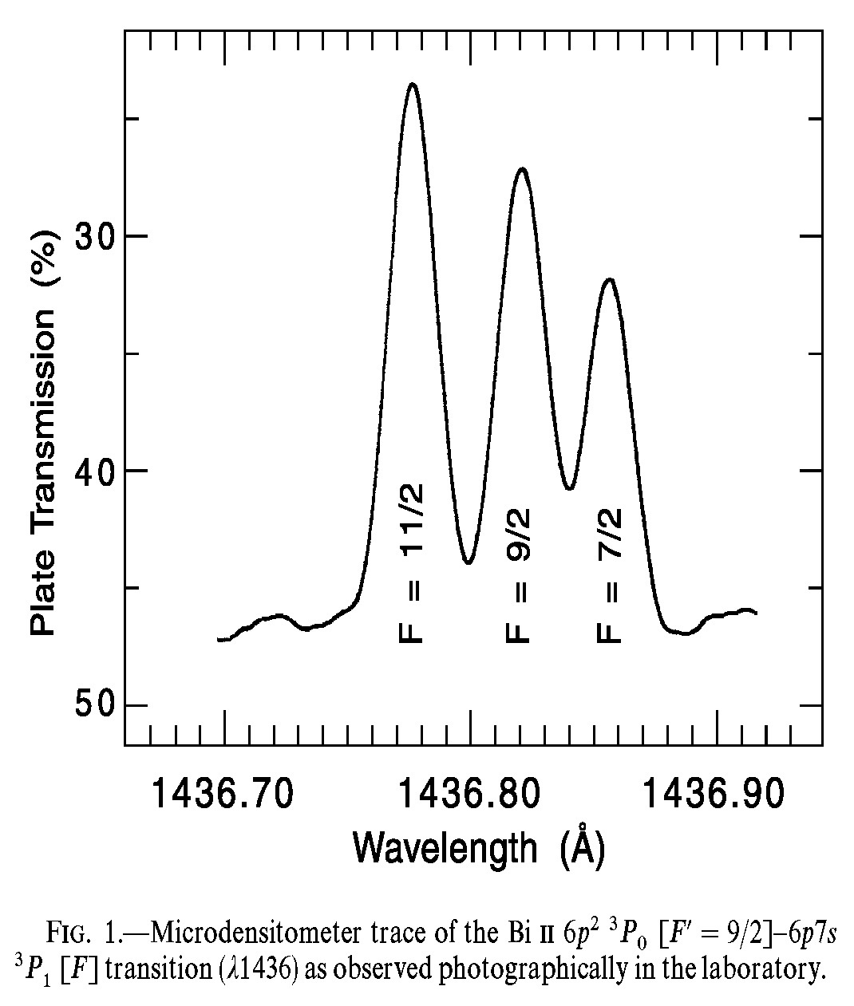
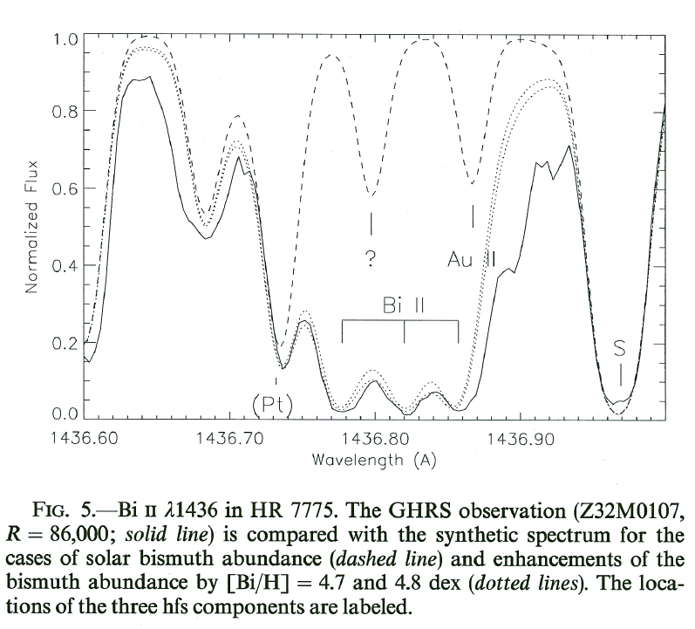
Measurement of the Bi Abundance in the Peculiar Star HR7775 Using NIST Laboratory Measurements of Bi II Wavelengths and hfs
From Wahlgren, et al. 2001, Ap.J., 551: 520-535

Slide 11
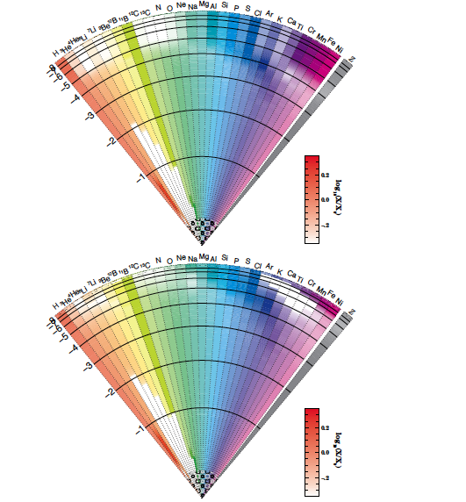
What Produces Abundance Anomalies in Stars and Why Is It Important?

Slide 12
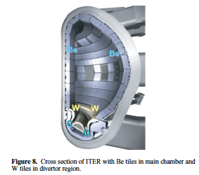
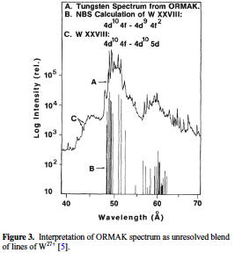
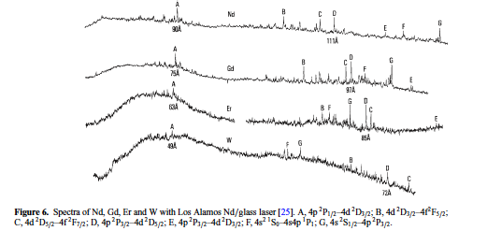
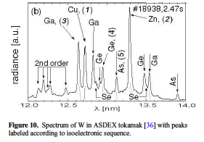
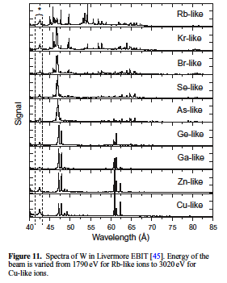
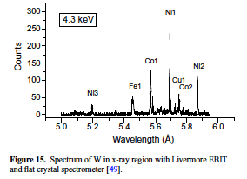
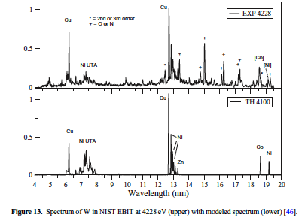
[from W⁺ to W⁷³⁺]
1977
1980
2005
2002
2004
2007

Slide 13
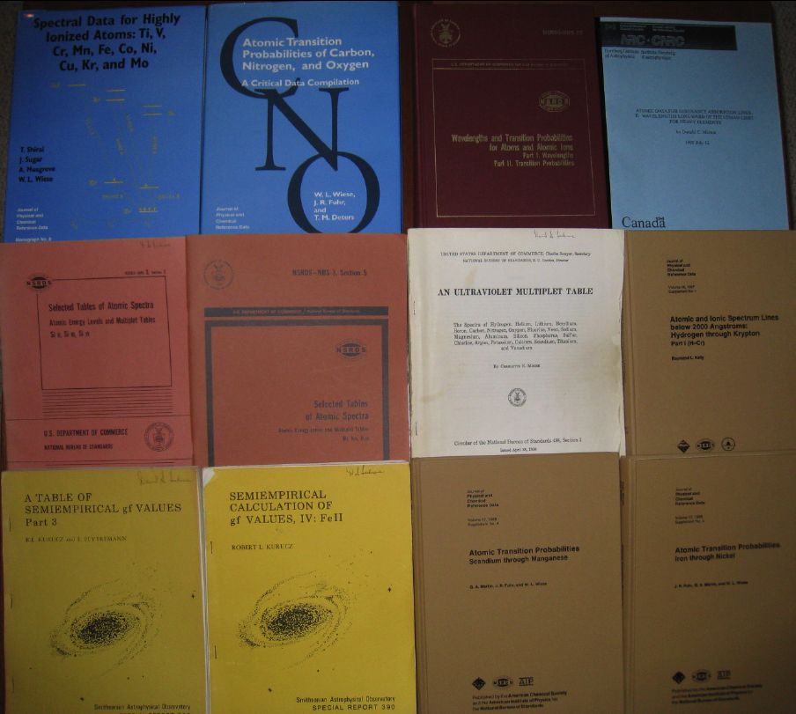

Slide 15
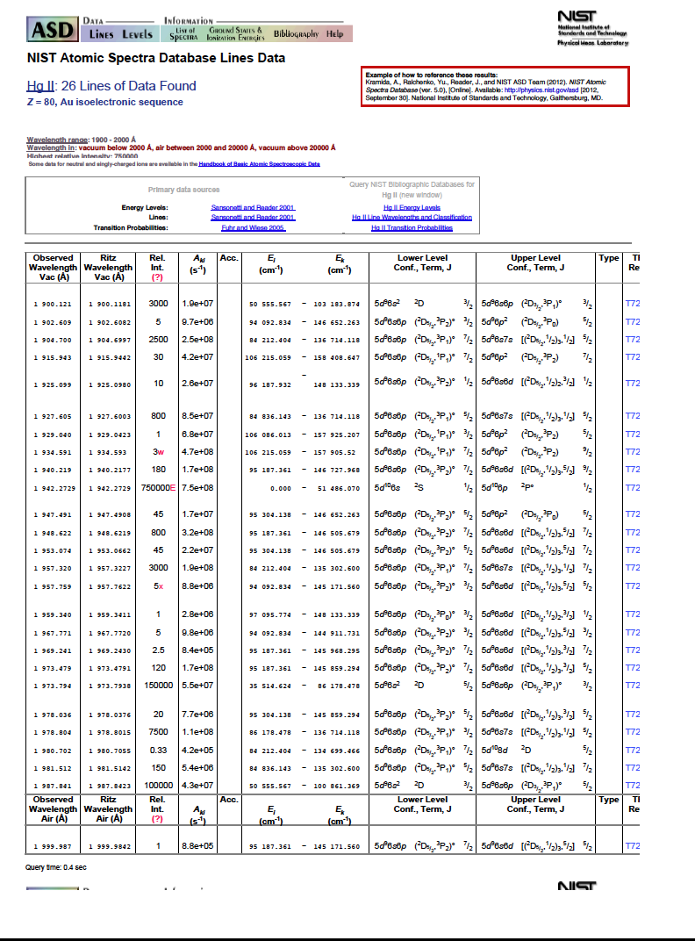

Slide 16
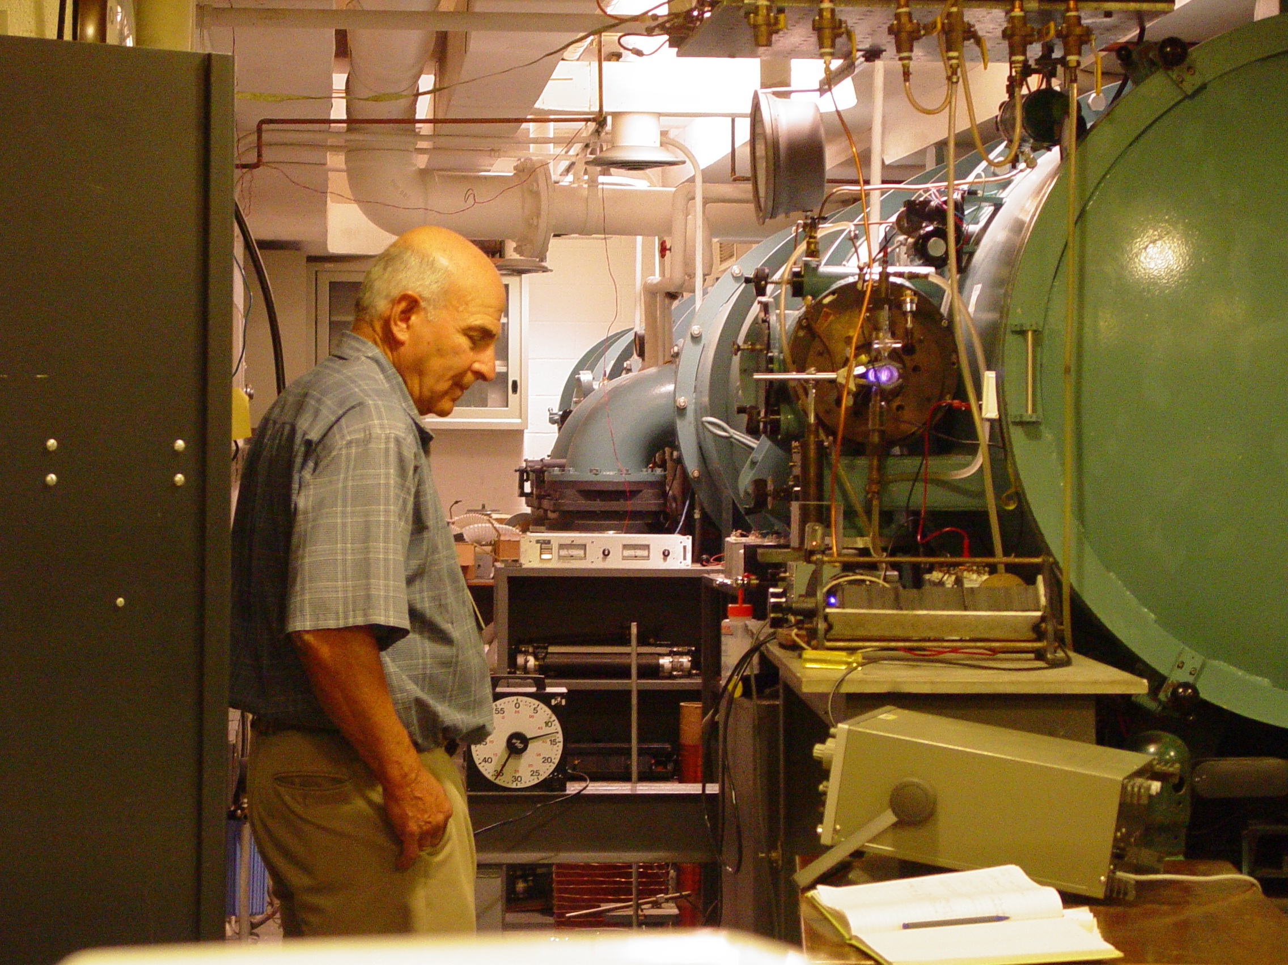
THANK YOU JOE!

