Slide 1
Data Needs for Simulations of Electron-driven Processes in Planetary and Cometary Atmospheres
by Laurence Campbell & Michael J. Brunger
School of Chemical and Physical Sciences, GPO Box 2100, Adelaide, SA 5001, Australia
Presented on Wednesday 3rd October 2012 at ICAMDATA 2012, Gaithersburg, Maryland, USA

Slide 2
Outline
Aims of our work
Inputs required
Atmospheric data
Electron flux spectrum
Electron impact cross sections
Other atomic and molecular data

Slide 3
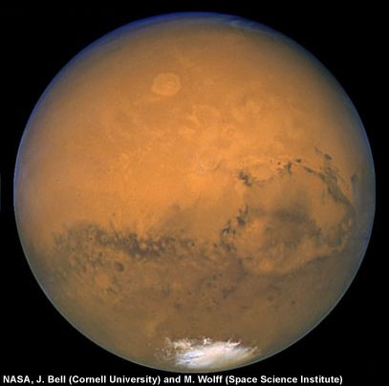
Outline
Aims of our work
Inputs required
Atmospheric data
Electron flux spectrum
Electron impact cross sections
Other atomic and molecular data
Examples
Electron cooling by CO₂ in the atmosphere of Mars

Slide 4
Outline
Aims of our work
Inputs required
Atmospheric data
Electron flux spectrum
Electron impact cross sections
Other atomic and molecular data
Examples
Electron cooling by CO₂ in the atmosphere of Mars
Infrared emissions from CO at Mars and Venus

Slide 5
Outline
Aims of our work
Inputs required
Atmospheric data
Electron flux spectrum
Electron impact cross sections
Other atomic and molecular data
Examples
Electron cooling by CO₂ in the atmosphere of Mars
Infrared emissions from CO at Mars and Venus
Predictions of A ¹Π emissions from CO in comet Hale-Bopp

Slide 6
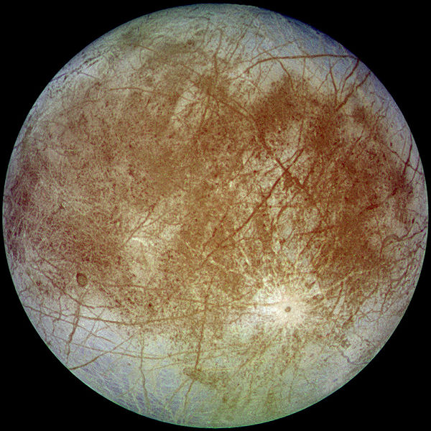
Outline
Aims of our work
Inputs required
Atmospheric data
Electron flux spectrum
Electron impact cross sections
Other atomic and molecular data
Examples
Electron cooling by CO₂ in the atmosphere of Mars
Infrared emissions from CO at Mars and Venus
Predictions of A ¹Π emissions from CO in comet Hale-Bopp
Electron impact excitation of higher-energy states of O₂ in the atmosphere of Europa

Slide 7
Outline
Aims of our work
Inputs required
Atmospheric data
Electron flux spectrum
Electron impact cross sections
Other atomic and molecular data
Examples
Electron cooling by CO₂ in the atmosphere of Mars
Infrared emissions from CO at Mars and Venus
Predictions of A ¹Π emissions from CO in comet Hale-Bopp
Electron impact excitation of higher-energy states of O₂ in the atmosphere of Europa
Electron heating in the atmosphere of Titan

Slide 8
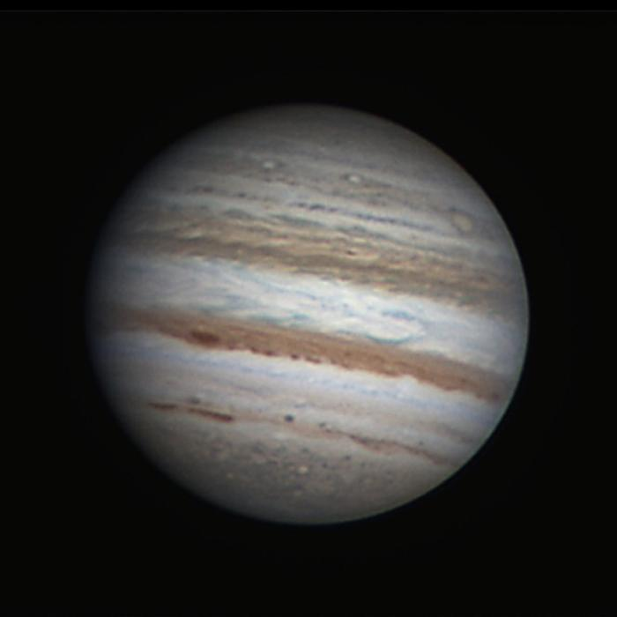
Outline
Aims of our work
Inputs required
Atmospheric data
Electron flux spectrum
Electron impact cross sections
Other atomic and molecular data
Examples
Electron cooling by CO₂ in the atmosphere of Mars
Infrared emissions from CO at Mars and Venus
Predictions of A ¹Π emissions from CO in comet Hale-Bopp
Electron impact excitation of higher-energy states of O₂ in the atmosphere of Europa
Electron heating in the atmosphere of Titan
Emissions from hydrogen at Jupiter
Conclusions

Slide 9
Aims
To enhance the role of electron-impact cross-section measurements in planetary and cometary modeling by:
Demonstrating the need for more accurate cross sections, as in:
electron cooling by CO₂ at Mars, and
electron heating at Titan.

Slide 10
Aims
To enhance the role of electron-impact cross-section measurements in planetary and cometary modeling by:
Demonstrating the need for more accurate cross sections, as in:
electron cooling by CO₂ at Mars, and
electron heating at Titan.
Encouraging new measurements of required cross sections, as in:
electron-driven infrared emissions from CO at Mars and Venus.

Slide 11
Aims
To enhance the role of electron-impact cross-section measurements in planetary and cometary modeling by:
Demonstrating the need for more accurate cross sections, as in:
electron cooling by CO₂ at Mars, and
electron heating at Titan.
Encouraging new measurements of required cross sections, as in:
electron-driven infrared emissions from CO at Mars and Venus.
Finding applications where electron impact has not been considered previously, such as
determination of the abundance of CO in comet Hale-Bopp, and
excitation of the higher-energy states of O₂ at Europa.

Slide 12
Electron cooling and heating
Electron cooling – thermal electrons lose energy by vibrational excitation of molecules
Energy
Electron impact
excitation
Time
Electron cooling

Slide 13
Electron cooling and heating
Electron cooling – thermal electrons lose energy by vibrational excitation of molecules
Radiative decay – polar molecules (CO, CO₂) radiate heat to space
Energy
Electron impact
excitation
Radiative
Decay
Time
Electron cooling
Energy lost from atmosphere

Slide 14
Electron cooling and heating
Electron cooling – thermal electrons lose energy by vibrational excitation of molecules
Radiative decay – polar molecules (CO, CO₂) radiate heat to space
Electron heating – for N₂, the vibrational energy is transferred to heat of neutral species in collisions
Energy
Electron impact
excitation
Radiative
Decay
Collisional
quenching
Time
Electron cooling
Energy lost from atmosphere
Electron heating (of atmosphere)

Slide 15
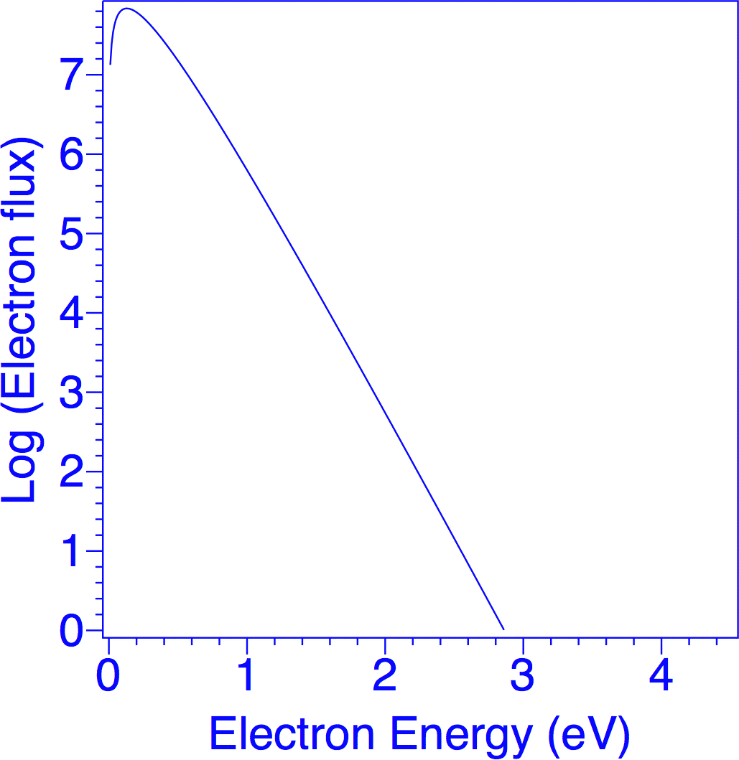
Electron cooling rate
We determine (from measurements or theory) a flux distribution F(E) i.e. the number of electrons of energy E crossing a unit area in unit time.

Slide 16
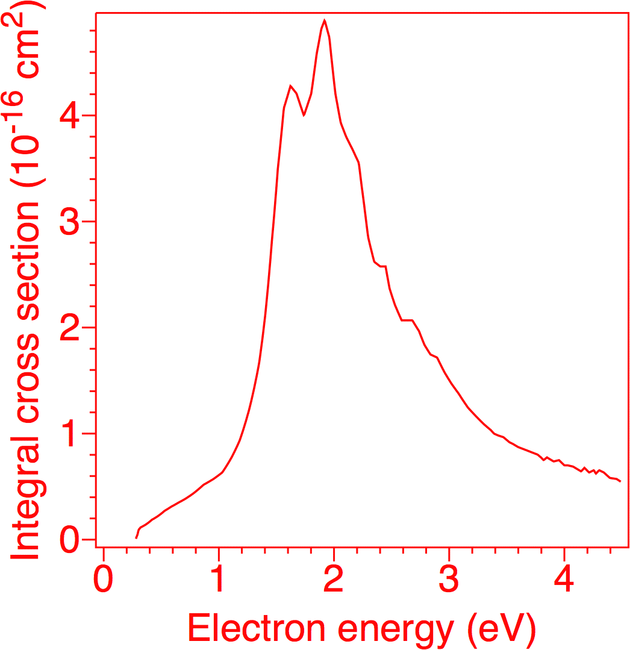
Electron cooling rate
We determine (from measurements or theory) a flux distribution F(E) i.e. the number of electrons of energy E crossing a unit area in unit time.
The flux distribution is folded with the Integral Cross Section σ_{0ν}(E) for vibrational excitation from ground to level ν to give the electron energy transfer rate Q_{0ν} :

Slide 17
Electron cooling rate
We determine (from measurements or theory) a flux distribution F(E) i.e. the number of electrons of energy E crossing a unit area in unit time.
The flux distribution is folded with the Integral Cross Section σ_{0ν}(E) for vibrational excitation from ground to level ν to give the electron energy transfer rate Q_{0ν} :
Electron cooling rate =

Slide 18
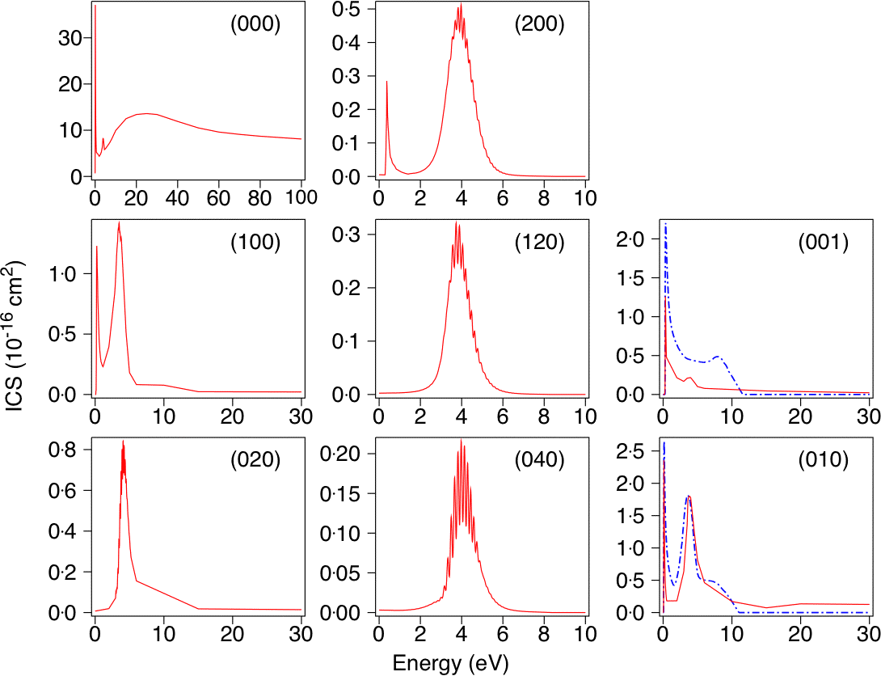
CO₂ electron impact excitation cross sections
Present ICS ( ) and ICS used by Morrison and Greene, 1978 ( )
Notes:
18

Slide 19
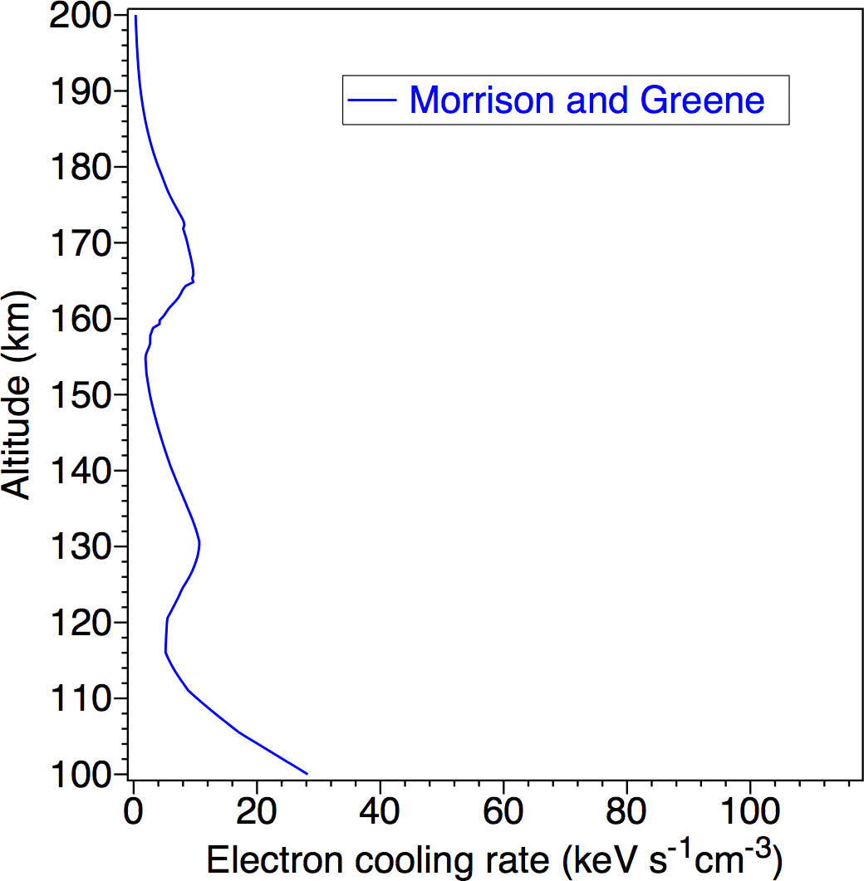
Mars - Calculated electron
cooling by CO₂
Using cross sections of Morrison and Green, 1978 ( ) for average electron density.
Notes:
19

Slide 20
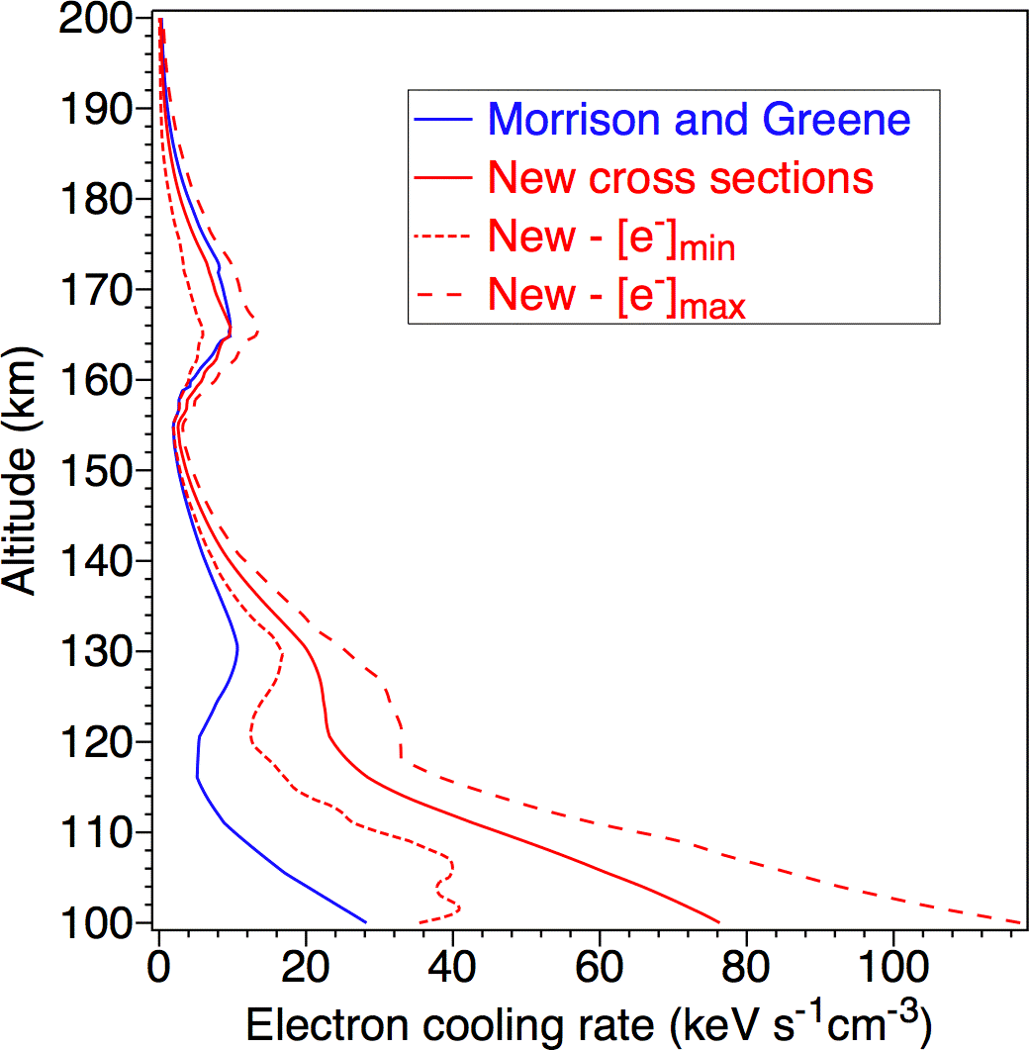
Mars - Calculated electron
cooling by CO₂
Using cross sections of Morrison and Green, 1978 ( ) for average electron density.
Using current cross sections for ( ) Average electron density (- - - - -) Minimum electron density ( ) Maximum electron density
Demonstrates importance of accurate electron-impact cross sections in planetary studies.
Notes:
20

Slide 21
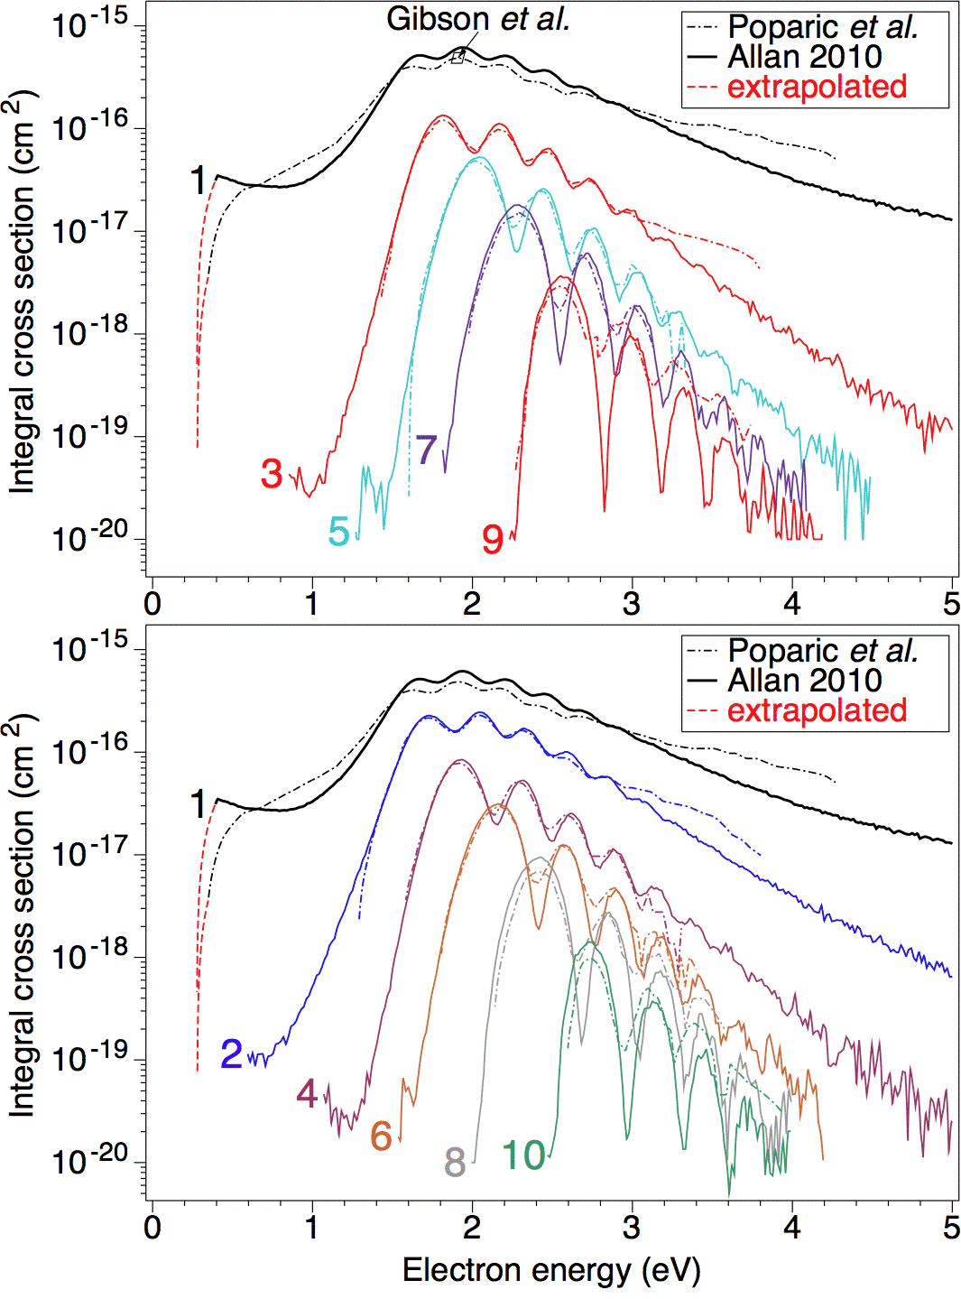
CO vibrational cross sections
Measurements of electron-impact vibrational cross sections for excitation of CO by:
(— - —) Poparić et al., 2006, scaled to Gibson et al., 1996 (☐ )
( ) Allan, 2010
(- - - - -) Extrapolated

Slide 22
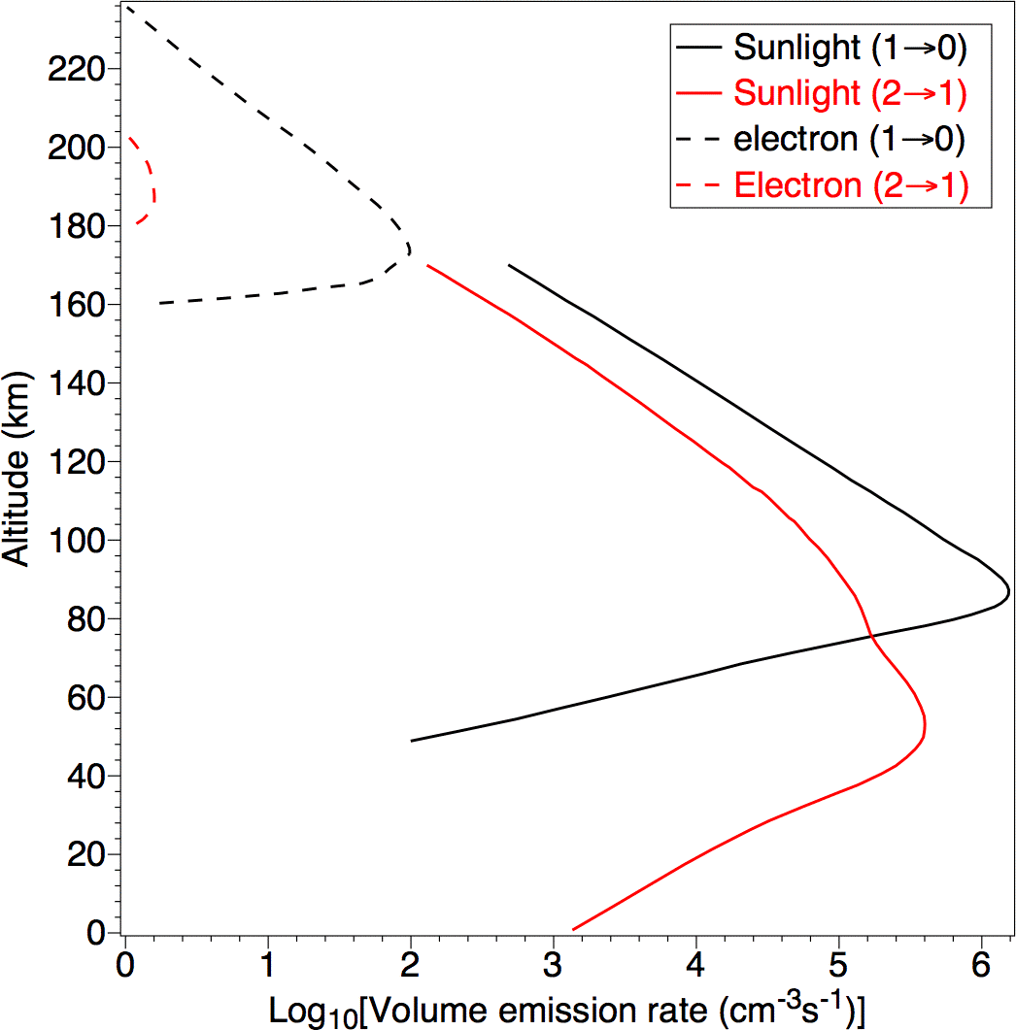
Mars daytime CO infrared emissions
Comparing (1→0) and (2→1) emissions for:
Electron-impact (- - - -)
Fluorescence and photolysis ( )

Slide 23
Mars daytime CO infrared emissions
Comparing (1→0) and (2→1) emissions for:
Electron-impact (- - - -)
Fluorescence and photolysis ( )
Electron impact is significant above ∼180 km for (1→0) emissions.

Slide 24
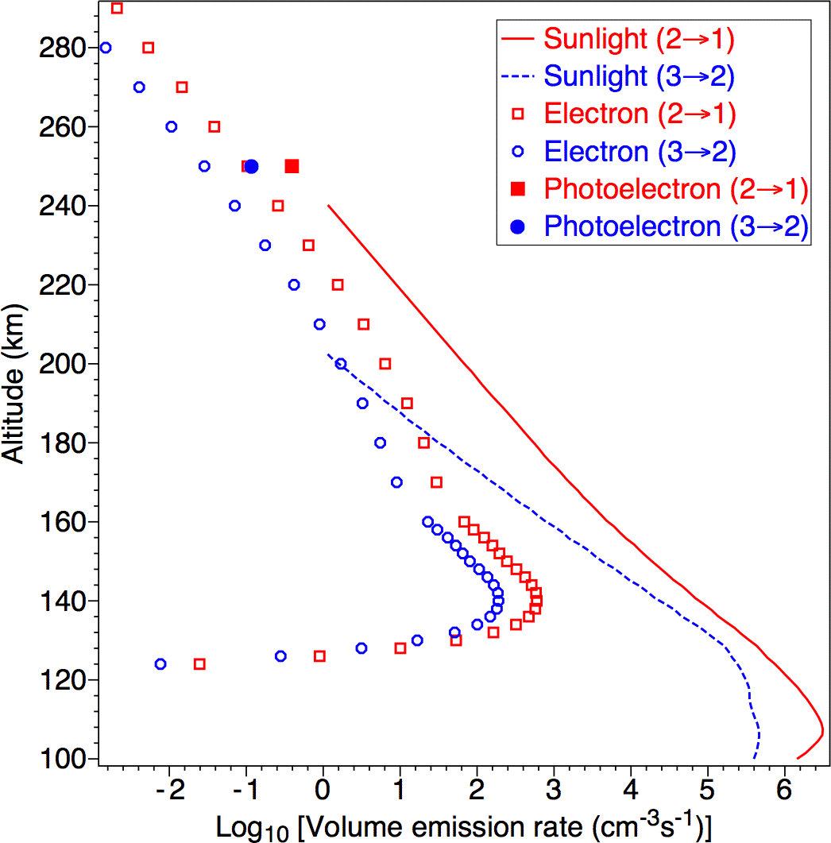
Venus daytime CO infrared emissions
Comparing (2→1) emissions for:
Sunlight ( )
Thermal + auroral (☐)
Photoelectrons ()
Comparing (3→2) emissions for:
Sunlight (- - - - -)
Thermal + auroral ()
Photoelectrons (•)
Electron-impact is significant above 190 km for (3→2) emissions.

Slide 25
Venus daytime CO infrared emissions
Comparing (2→1) emissions for:
Sunlight ( )
Thermal + auroral (☐)
Photoelectrons ()
Comparing (3→2) emissions for:
Sunlight (- - - - -)
Thermal + auroral ()
Photoelectrons (•)
Electron-impact is significant above 190 km for (3→2) emissions. Photoelectron impact is significant at 250 km for (2→1) emissions.

Slide 26
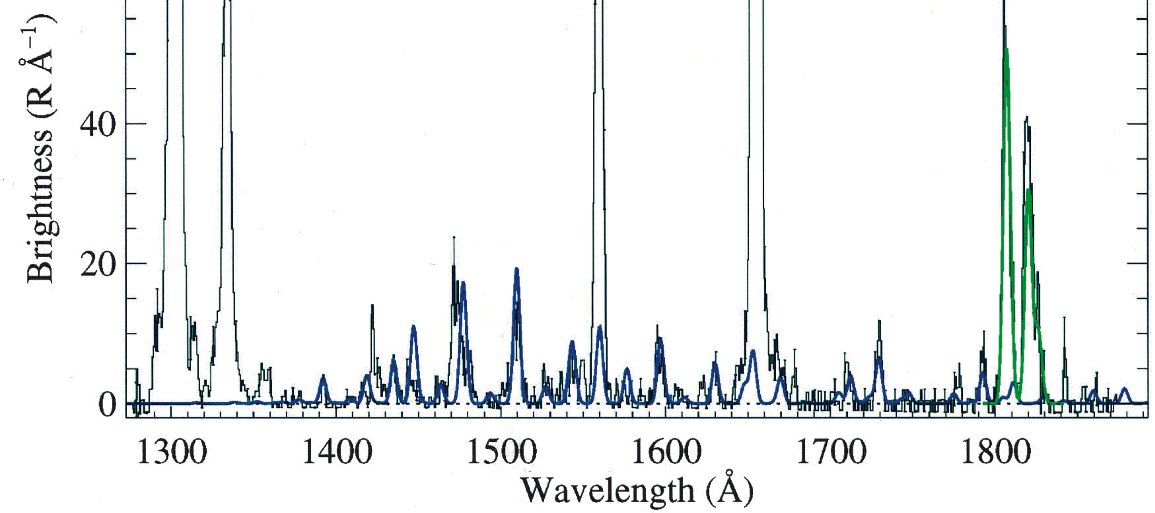
CO in comet Hale-Bopp
A spectrum ( ) of emissions from the coma of comet Hale-Bopp. The authors superimposed a fitted spectrum ( ) of the fourth positive (A¹Π→X¹Σ⁺) band emissions of CO, from which they determined the abundance of CO in the coma. It was assumed that the CO emissions were due to fluorescence induced by sunlight, without any contribution from photoelectron impact.
Observed
Fitted S I lines
O I lines
Fitted CO
Notes:
26

Slide 27
CO in comet Hale-Bopp
A spectrum ( ) of emissions from the coma of comet Hale-Bopp. The authors superimposed a fitted spectrum ( ) of the fourth positive (A¹Π→X¹Σ⁺) band emissions of CO, from which they determined the abundance of CO in the coma. It was assumed that the CO emissions were due to fluorescence induced by sunlight, without any contribution from photoelectron impact.
Observed
Fitted S I lines
O I lines
Fitted CO
Notes:
27

Slide 28
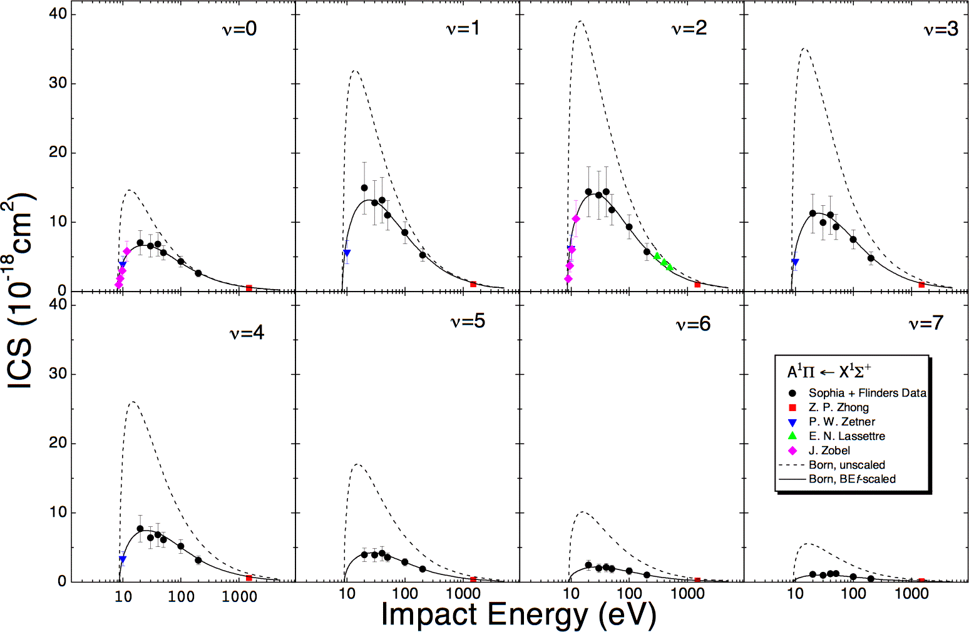
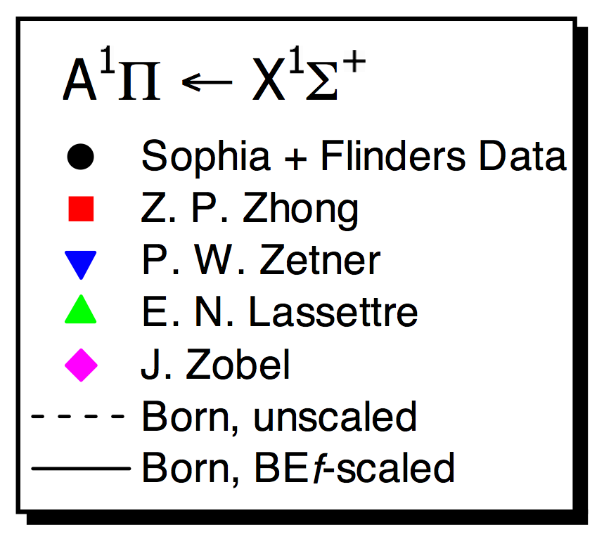
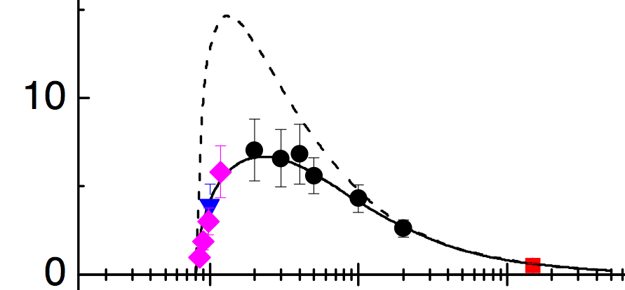
Recent cross sections Cross section examples and comparison with theory
CO
A ¹Π
ν=0
Notes:
28

Slide 29
Recent cross sections Cross section examples and comparison with theory
CO
A ¹Π
Notes:
29

Slide 30
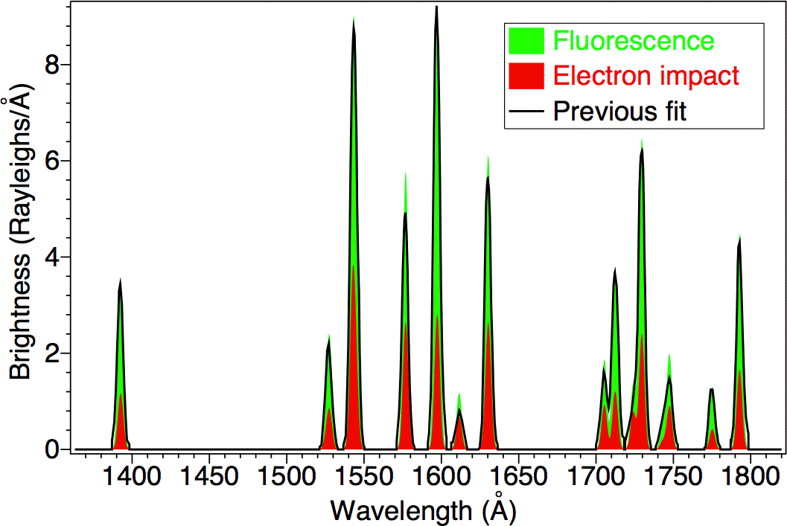
CO in comet Hale-Bopp
We find that electron impact () makes a substantial contribution, thus reducing the implied amount of fluorescence (). Hence the implied CO abundance is reduced by 40%.
Notes:
30

Slide 31
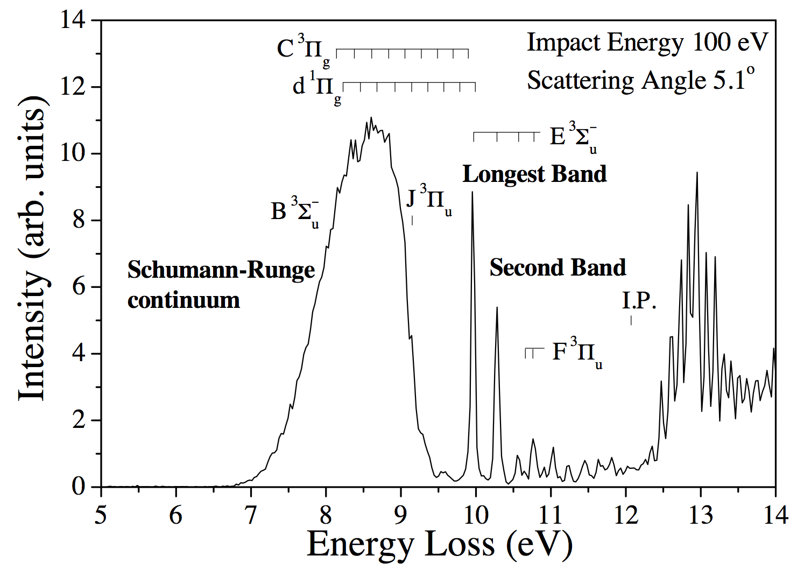
O₂ - Measurements at Sophia – sample energy loss spectrum

Slide 32
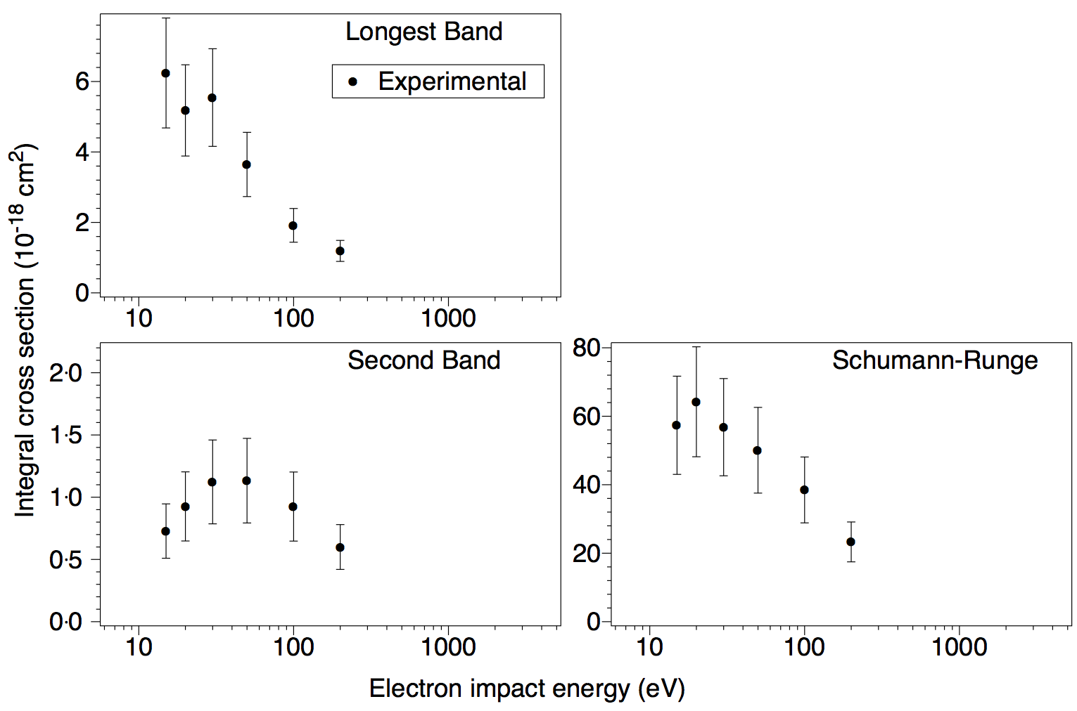
Measurements – Integral cross sections
(•) Measurements

Slide 33
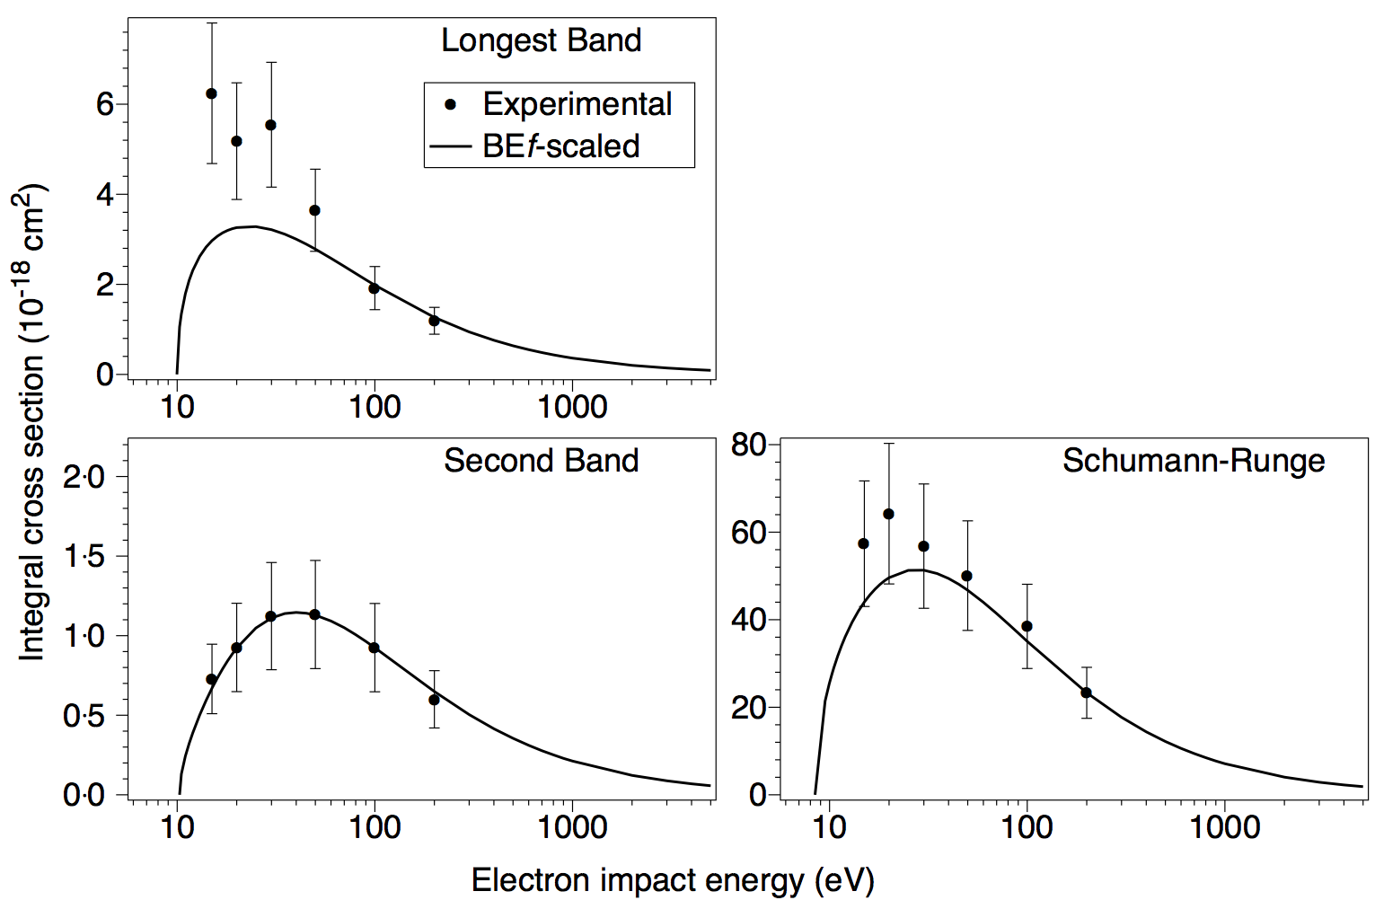
Measurements – Integral cross sections
(•) Measurements
( ) BEf-scaled predictions
(Suzuki et al., 2010)

Slide 34
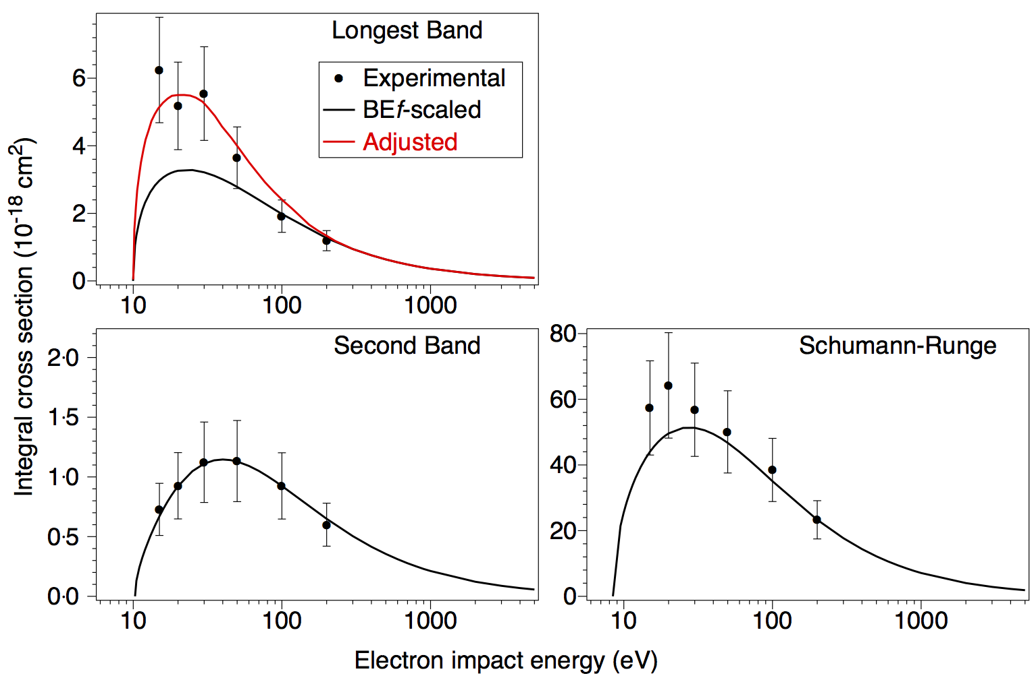
Measurements – Integral cross sections
(•) Measurements
( ) BEf-scaled predictions
(Suzuki et al., 2010) ( ) Adjusted cross sections are used for the longest band.

Slide 35
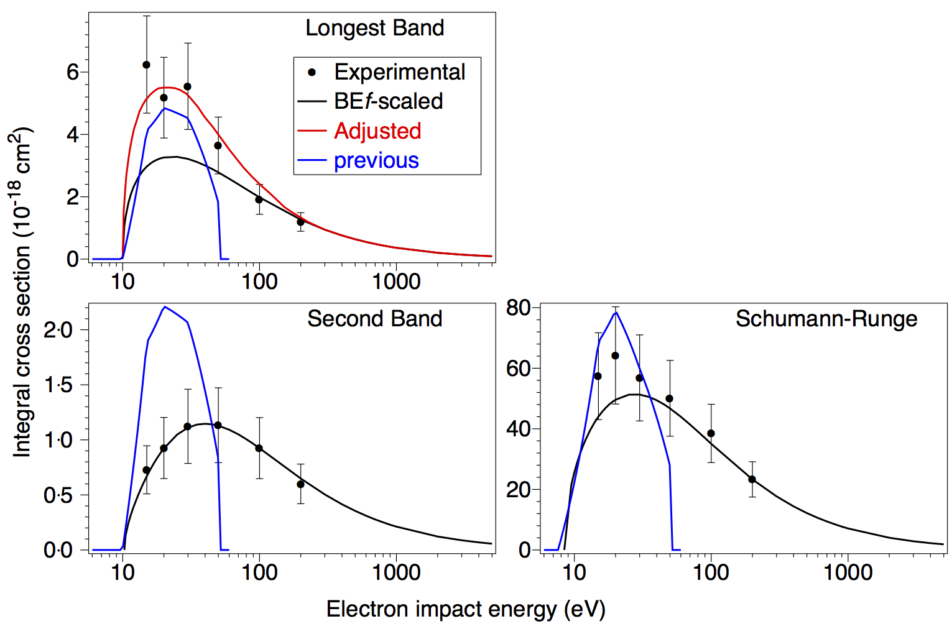
Measurements – Integral cross sections
(•) Measurements
( ) BEf-scaled predictions
(Suzuki et al., 2010) ( ) Adjusted cross sections are used for the longest band.
( ) Previous measurements
(Shyn et al., 1994)

Slide 36
Decay and predissociation
Radiative decay only for vibrational levels below 7.01 eV

Slide 37
Decay and predissociation
Radiative decay only for vibrational levels below 7.01 eV
Excitation results in predissociation above 7.01 eV

Slide 38
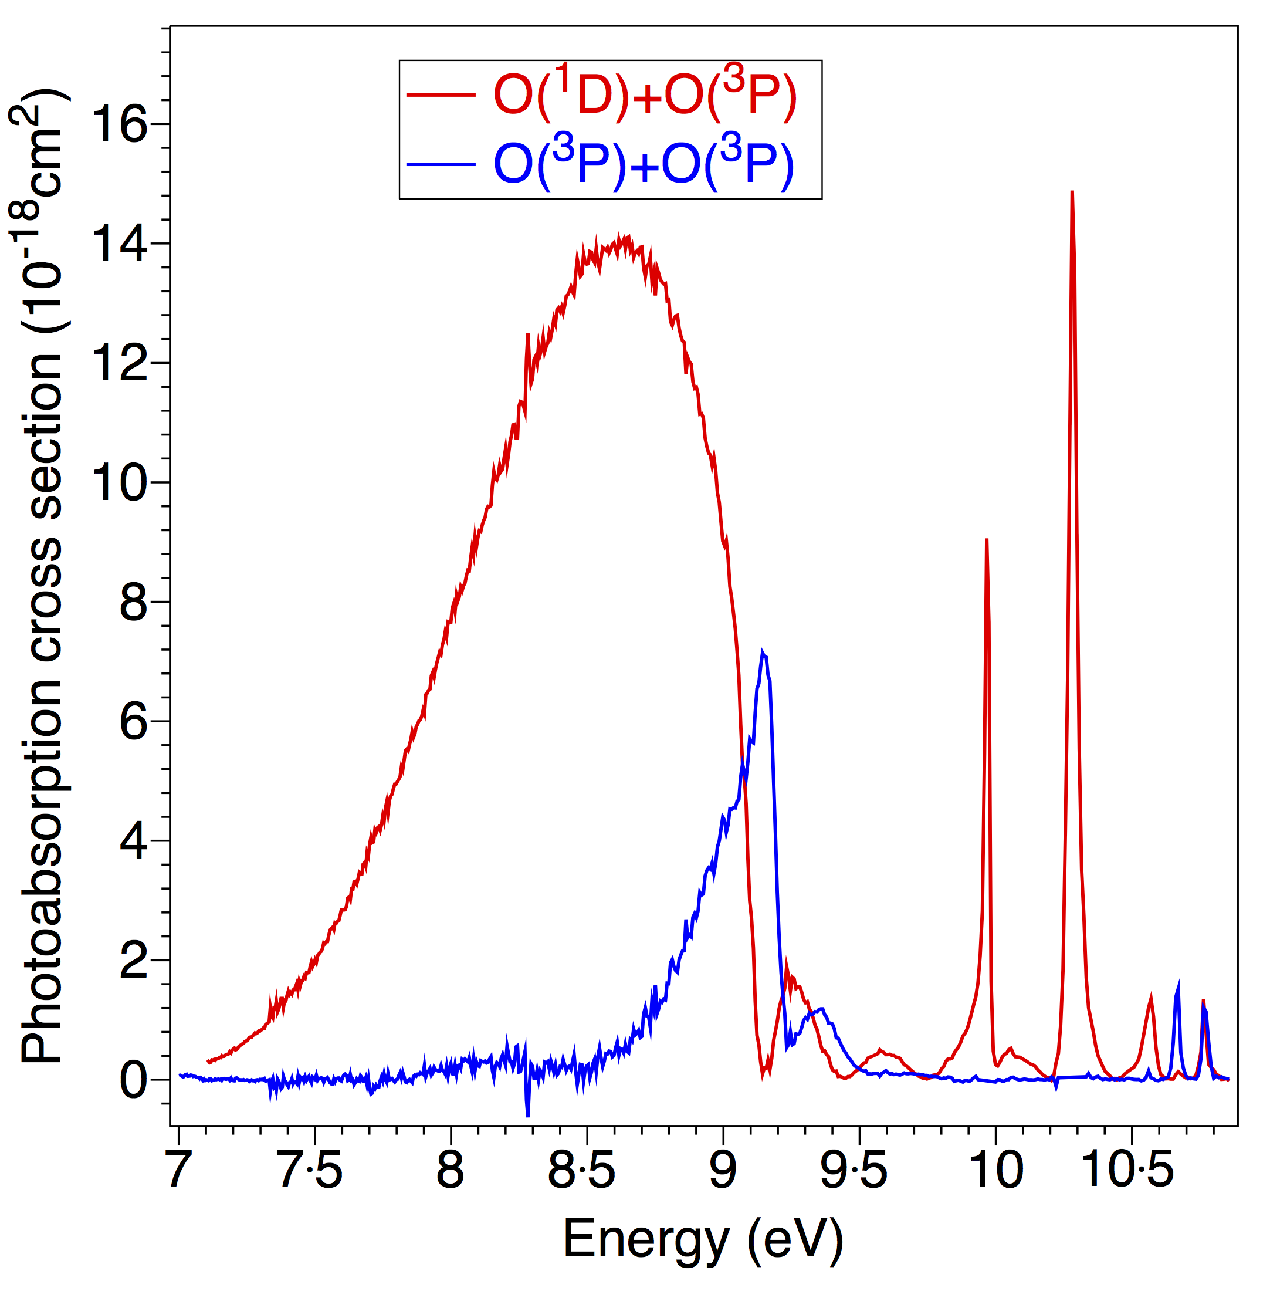
Decay and predissociation
Measurements of predissociation channels by Stephen Gibson:
( ) O₂→ O(¹D)+O(³P)
( ) O₂→ O(³P)+O(³P)
Radiative decay only for vibrational levels below 7.01 eV
Excitation results in predissociation above 7.01 eV

Slide 39
Atomic and molecular processes
Excitation
O₂ SB
O₂ LB
O₂ SR(r)
ground
Time (schematic)

Slide 40
Atomic and molecular processes
Excitation
O₂ SB
O₂ LB
O₂ SR(r)
O(¹D)
ground
Predissociation
Time (schematic)

Slide 41
Atomic and molecular processes
Excitation
O₂ SB
O₂ LB
O₂ SR(r)
O(¹D)
ground
Predissociation
Quenching
Time (schematic)

Slide 42
Atomic and molecular processes
Excitation
O₂ SB
O₂ LB
O₂ SR(r)
Radiation
O(¹D)
ground
Predissociation
Quenching
Time (schematic)

Slide 43
Atomic and molecular processes
Excitation
O₂ SB
O₂ LB
O₂ SR(r)
Radiation
O(¹S)
O(¹D)
ground
Predissociation
Quenching
Time (schematic)

Slide 44
Atomic and molecular processes
O₂⁺
Ionisation
Excitation
O₂ SB
O₂ LB
O₂ SR(r)
Radiation
O(¹S)
O(¹D)
ground
Predissociation
Quenching
Time (schematic)

Slide 45
Atomic and molecular processes
O₂⁺
Ionisation
Excitation
O₂ SB
O₂ LB
O₂ SR(r)
Recombination
Radiation
O(¹S)
O(¹D)
ground
Predissociation
Quenching
Time (schematic)

Slide 46
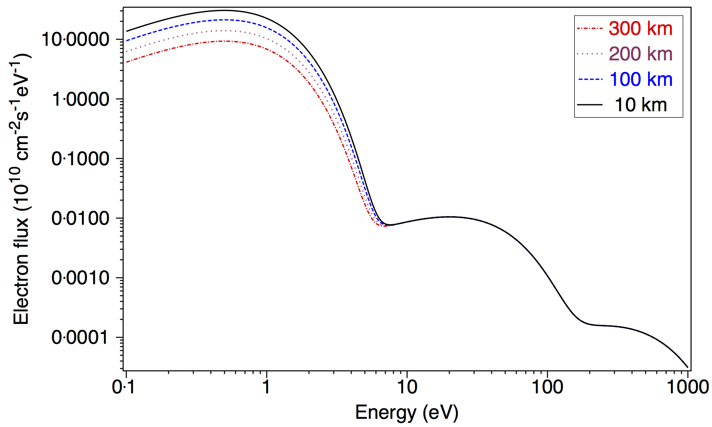
Electron flux spectrum for Europa
Secondary electrons
Magnetospheric flux

Slide 47
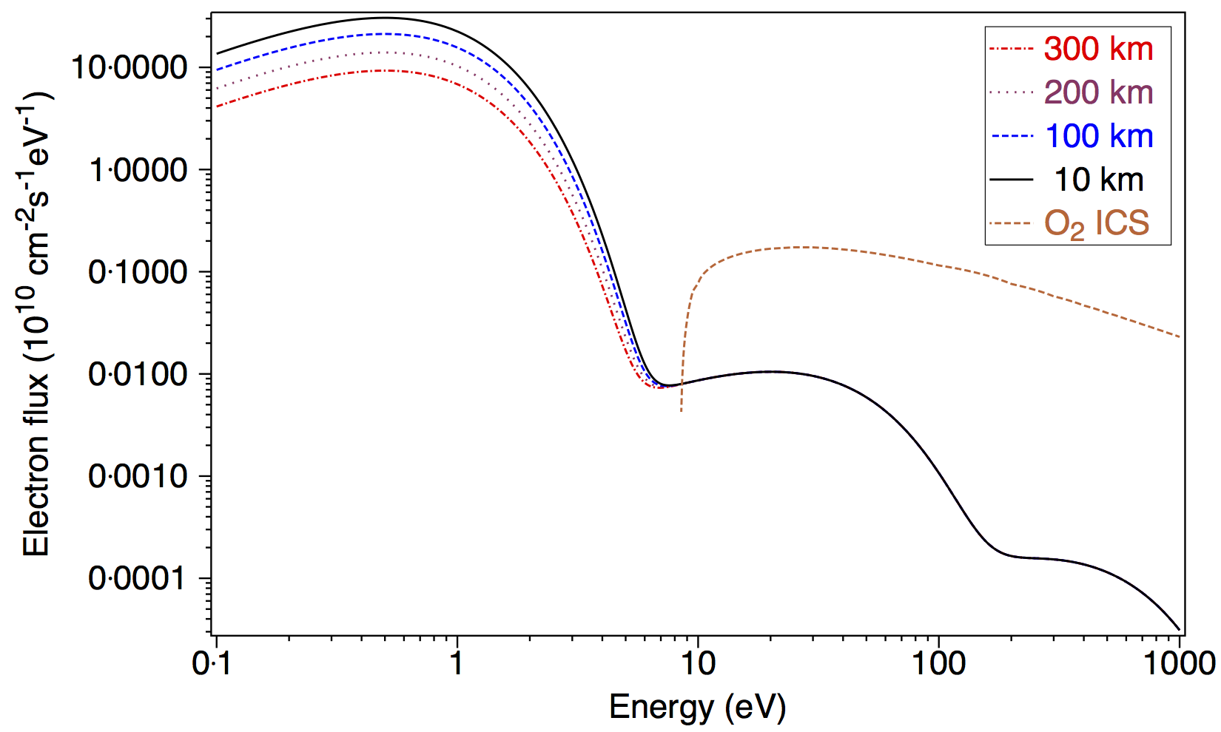
Electron flux spectrum for Europa
Secondary electrons
Magnetospheric flux

Slide 48
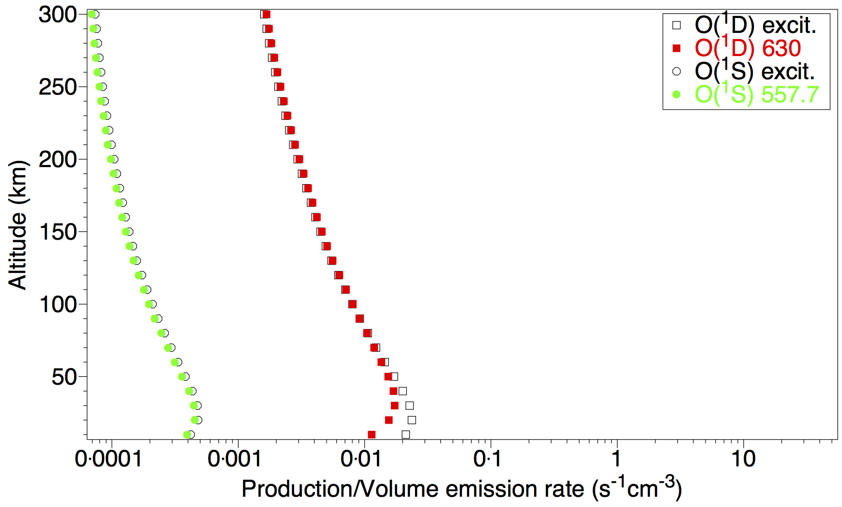
Predicted volume emission rates for Europa

Slide 49
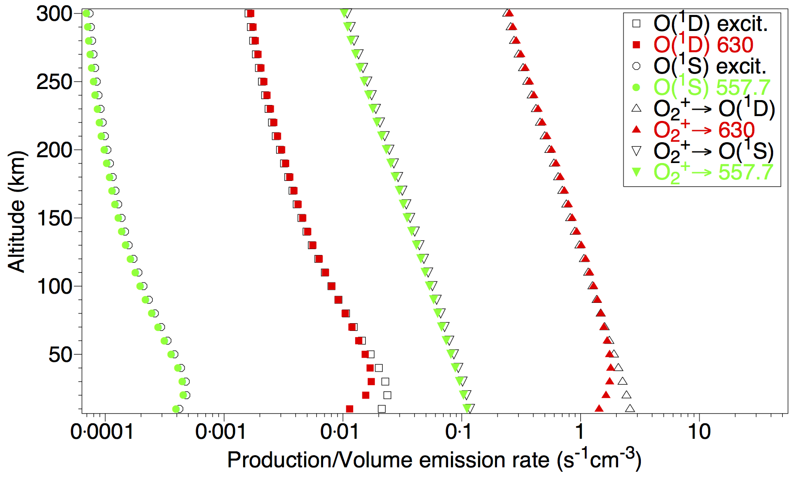
Predicted volume emission rates for Europa

Slide 50
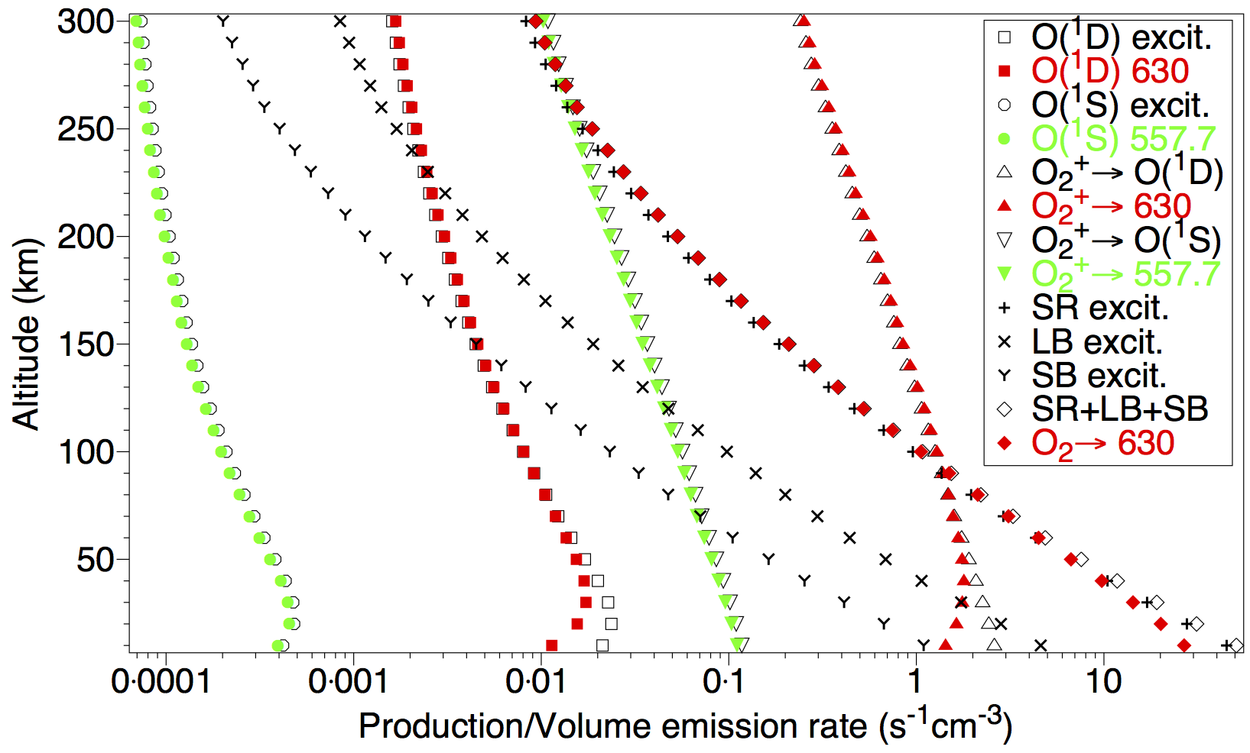
Predicted volume emission rates for Europa

Slide 51
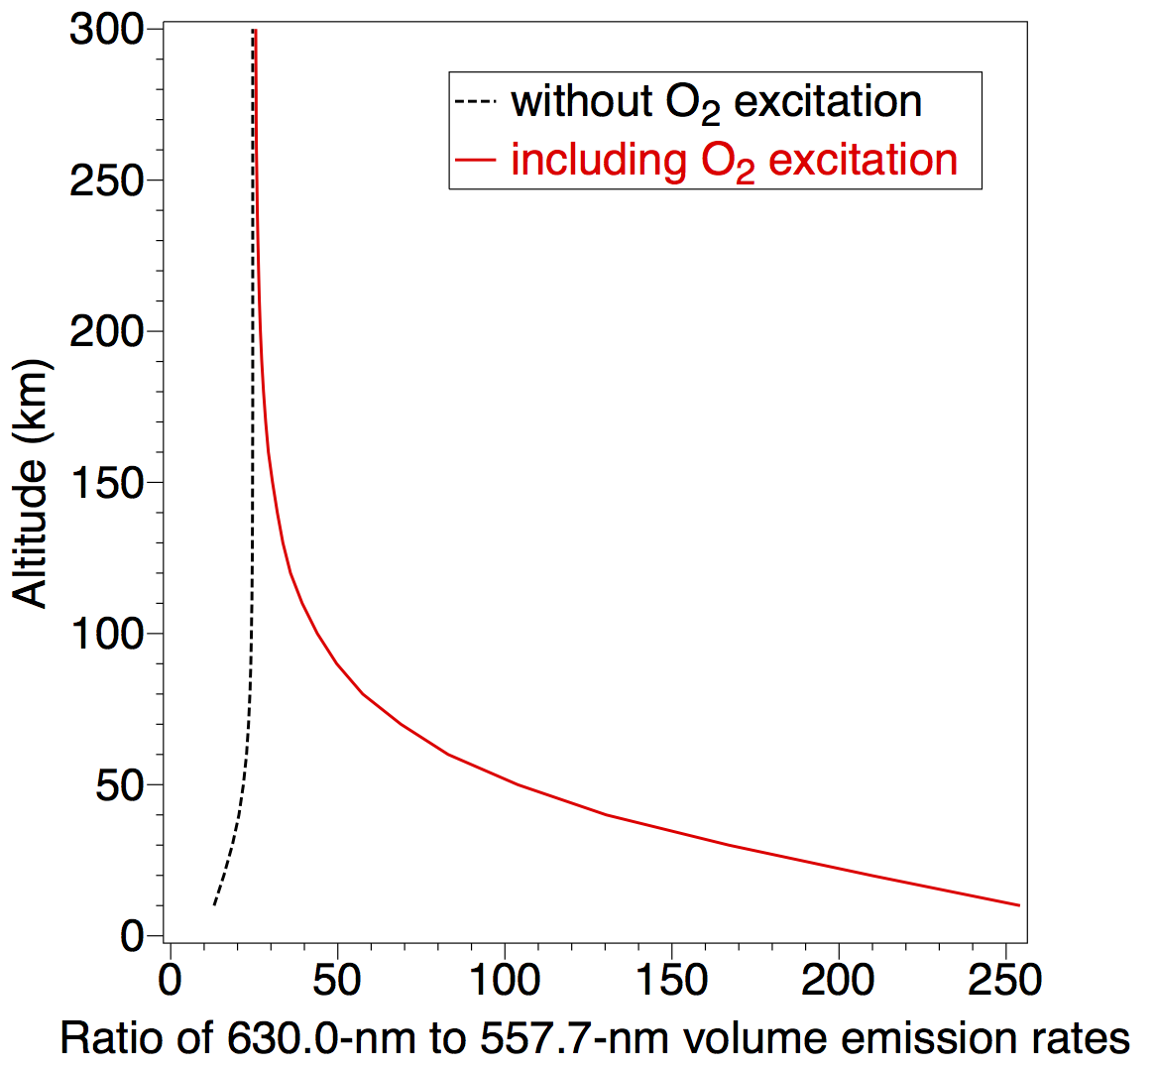
Predicted 630.0-nm/557.7-nm ratio for Europa
The predicted ratio of the 630.0-nm to 557.7-nm intensities is shown as a function of altitude in the atmosphere of Europa, for:
(----) excitation of O atoms and recombination of O₂⁺. ( ) as above, plus excitation of the Schumann-Runge continuum, longest band and second band of O₂.

Slide 52
Titan – range of processes in N₂
Previous study
Electron impact excitation (①)
Radiative transitions ()
Previous study

Slide 53
Titan – range of processes in N₂
Previous study (lower) and updated study (upper).
Electron impact excitation (①)
Radiative transitions ( or |)
Predissociation ()
Quenching (②)
Previous study

Slide 54
Titan – Electron heating
Previous study (lower) and updated study (upper).
Electron impact excitation (①)
Radiative transitions ( or |)
Predissociation ()
Quenching (②)
Electron heating ( )
Previous study

Slide 55
Statistical-equilibrium calculation
Energy
State β
i
Statistical equilibrium - solve simultaneous continuity equations until:
population(α_{ν′}) x loss rate
= total gain of α_{ν′}
State α
ν′
Excitation
State X

Slide 56
Statistical-equilibrium calculation
Energy
State β
i
Statistical equilibrium - solve simultaneous continuity equations until:
population(α_{ν′}) x loss rate
= total gain of α_{ν′}
Radiative
Decay
State α
ν′
Excitation
State X

Slide 57
Statistical-equilibrium calculation
Energy
State β
i
Statistical equilibrium - solve simultaneous continuity equations until:
population(α_{ν′}) x loss rate
= total gain of α_{ν′}
Radiative
Decay
State α
ν′
Excitation
State γ
j
State X

Slide 58
Statistical-equilibrium calculation
Energy
State β
i
Statistical equilibrium - solve simultaneous continuity equations until:
population(α_{ν′}) x loss rate
= total gain of α_{ν′}
Radiative
Decay
State α
ν′
Excitation
Quenching
(electron heating)
State γ
j
State X

Slide 59
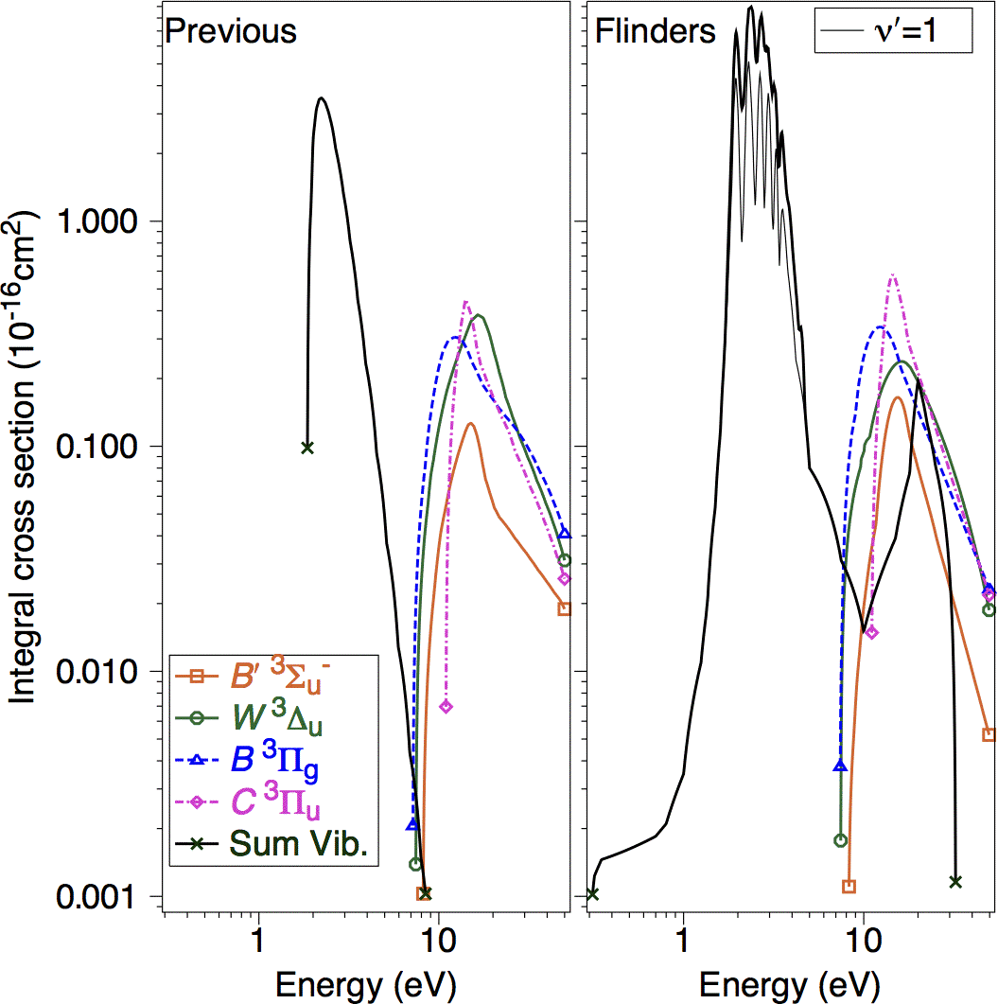
Previous and current N₂ cross sections
In previous calculations old N₂ cross sections (left) were used.
We have repeated the calculations using more recent (right) cross sections.

Slide 60
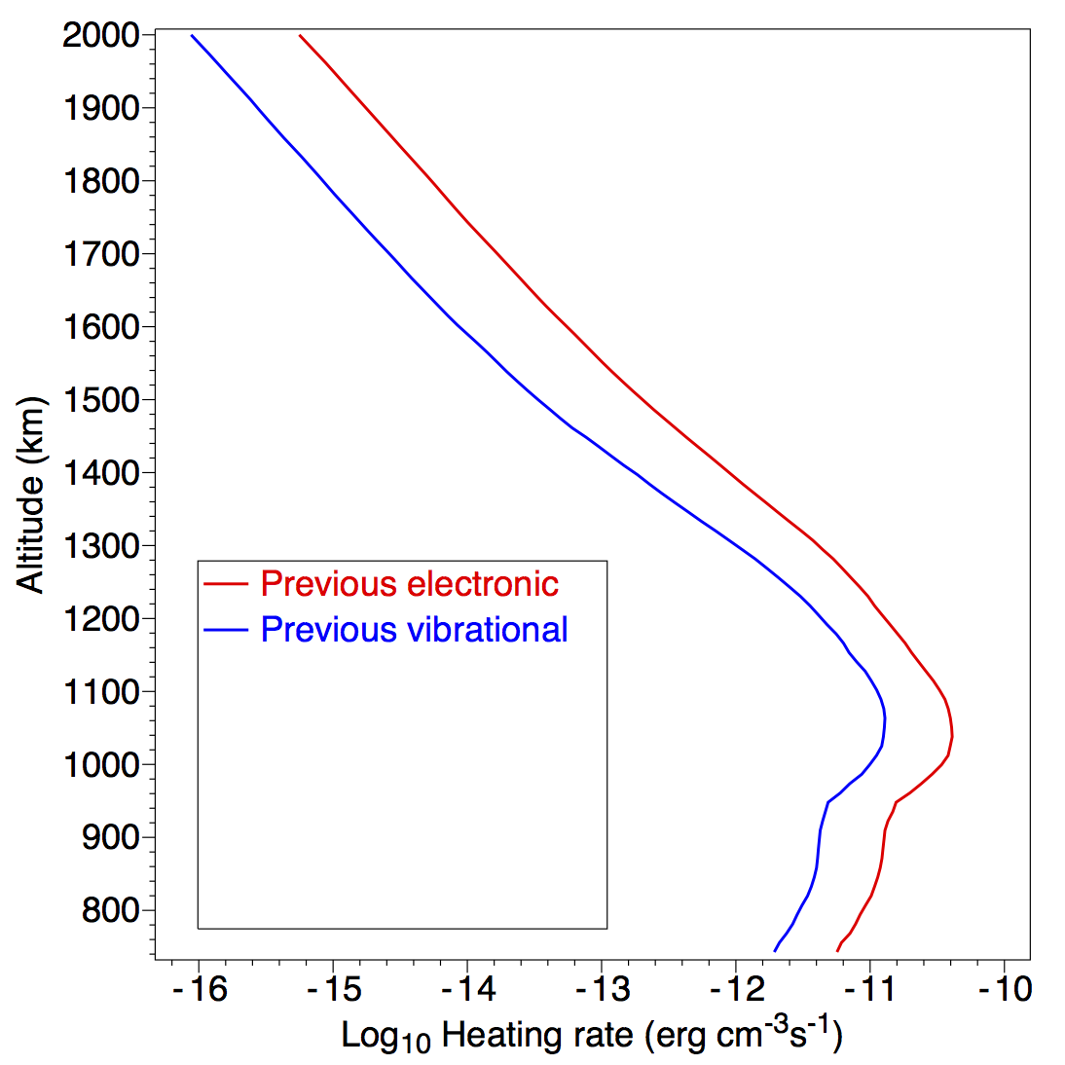
Titan – electron heating rates
Previous study:
Electronic states
Vibrational (ν′=1)

Slide 61
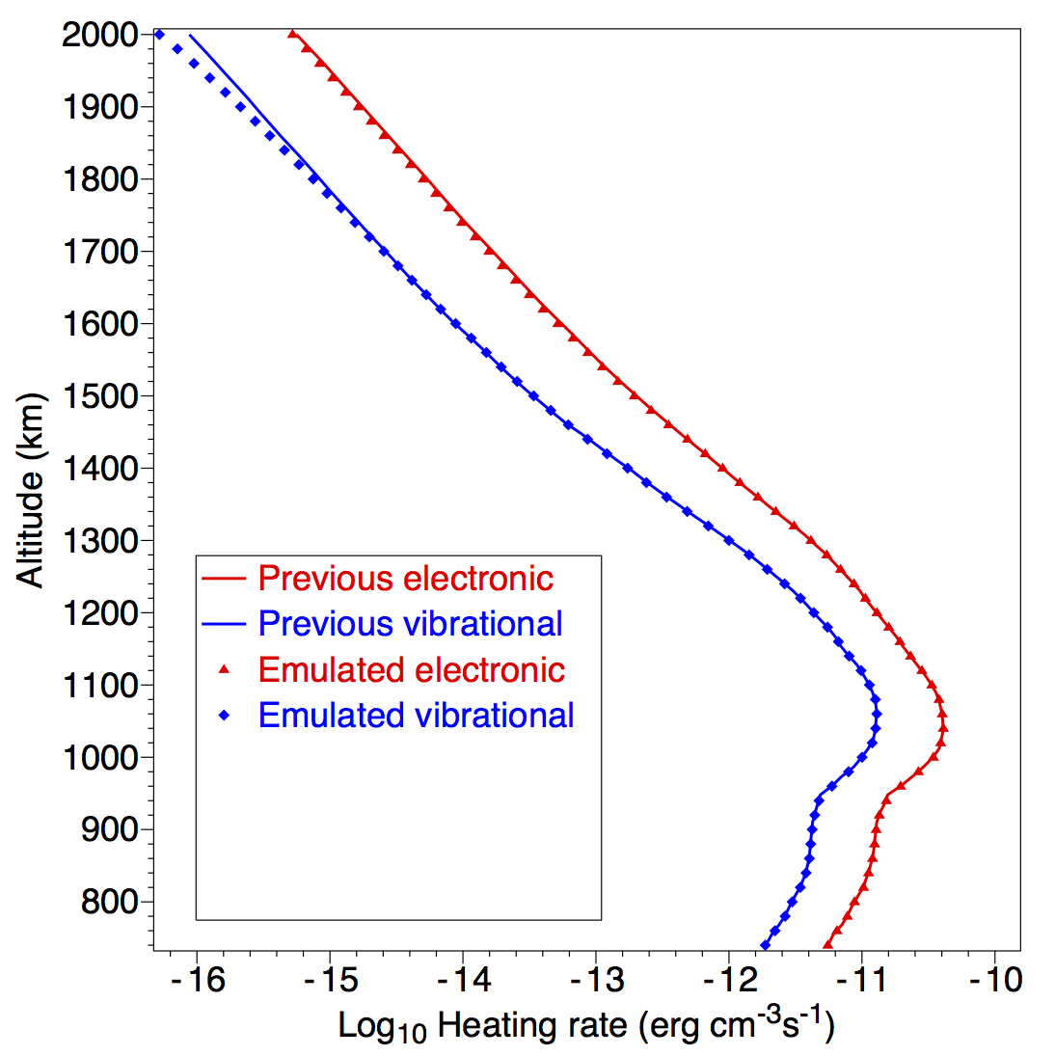
Titan – electron heating rates
Previous study:
Electronic states
Vibrational (ν′=1)
Emulation of
previous study:
Electronic states
Vibrational

Slide 62
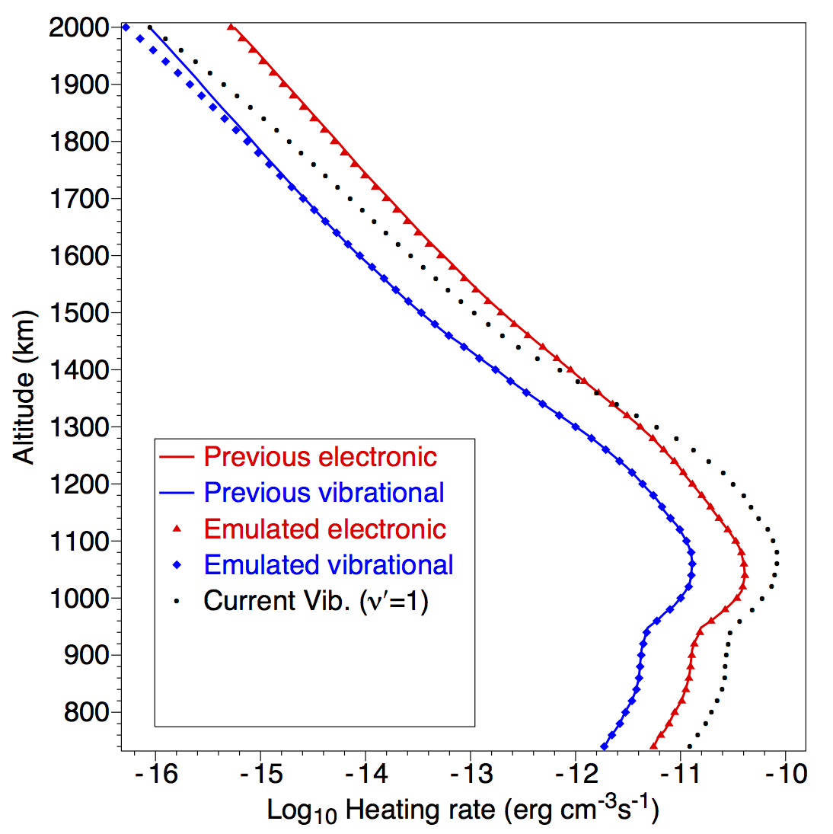
Titan – electron heating rates
Previous study:
Electronic states
Vibrational (ν′=1)
Emulation of
previous study:
Electronic states
Vibrational
New study:
Vibrational (ν′=1)

Slide 63
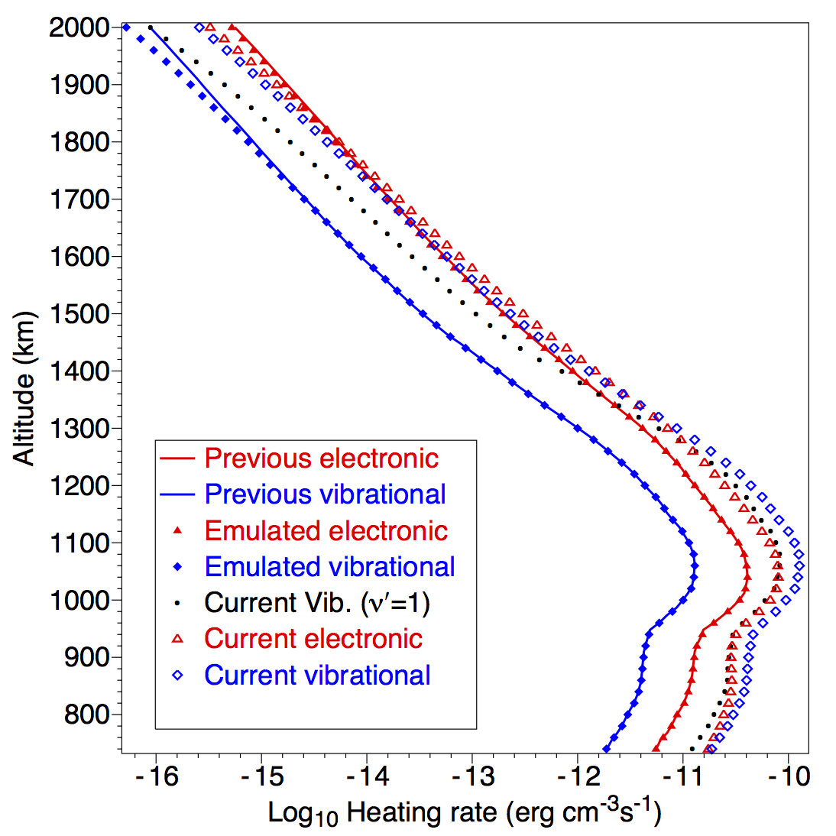
Titan – electron heating rates
Previous study:
Electronic states
Vibrational (ν′=1)
Emulation of
previous study:
Electronic states
Vibrational
New study:
Vibrational (ν′=1)
Electronic states
Vibrational (ν′=1-10)

Slide 64
Titan- data needs for improved calculation
Measurements of collision-induced electronic transitions (CIETs)
for verification of recent theoretical values by Kirillov, 2012.

Slide 65
Titan- data needs for improved calculation
Measurements of collision-induced electronic transitions (CIETs)
for verification of recent theoretical values by Kirillov, 2012.
Electron-impact excitation cross sections for higher-energy excited states of N₂. (New measurements by Kato et al., 2010 and Khakoo et al., 2008).
Predissociation, radiative-transition and quenching probabilities of these states.

Slide 66
Titan- data needs for improved calculation
Measurements of collision-induced electronic transitions (CIETs)
for verification of recent theoretical values by Kirillov, 2012.
Electron-impact excitation cross sections for higher-energy excited states of N₂. (New measurements by Kato et al., 2010 and Khakoo et al., 2008).
Predissociation, radiative-transition and quenching probabilities of these states.
Reaction rates for excited N₂ e.g. N₂[A ³Σ_{u}⁺ ] + O → NO + N(²D).
Update of values by Herron, 1999 and Kochetov et al., 1987.

Slide 67
Titan- data needs for improved calculation
Measurements of collision-induced electronic transitions (CIETs)
for verification of recent theoretical values by Kirillov, 2012.
Electron-impact excitation cross sections for higher-energy excited states of N₂. (New measurements by Kato et al., 2010 and Khakoo et al., 2008).
Predissociation, radiative-transition and quenching probabilities of these states.
Reaction rates for excited N₂ e.g. N₂[A ³Σ_{u}⁺ ] + O → NO + N(²D).
Update of values by Herron, 1999 and Kochetov et al., 1987.
Electron-impact excitation cross sections for CH₄.
Rates for vibrational-vibrational (VV) and vibrational-translational (VT) interactions between CH₄ and N₂.

Slide 68
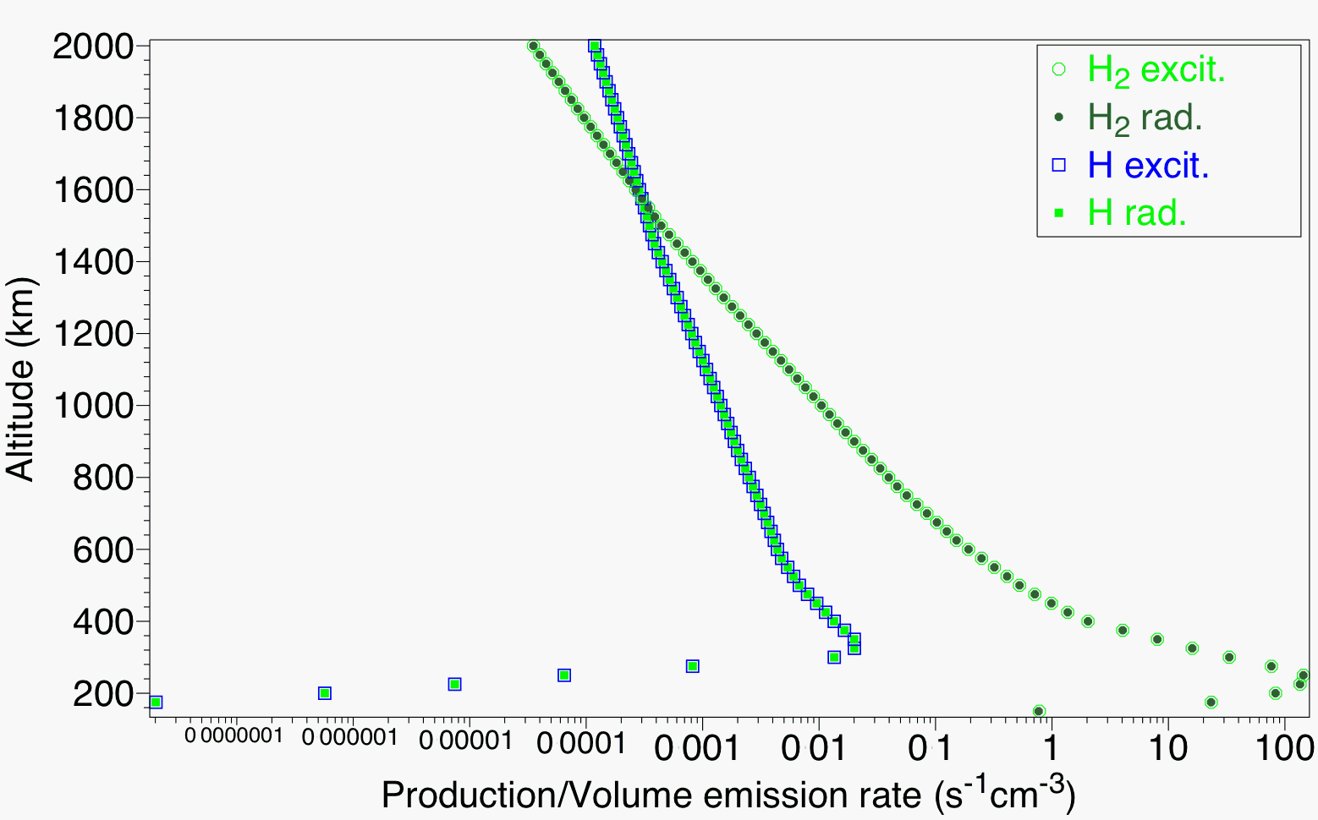
Jupiter – Lyman-α emissions
Two electron impact processes:
Direct excitation: e + H(1s) ➔ e + H(2p) ⬇ H(1s) + Lyman-α
(using CCC calculation, Zammit, 2010)

Slide 69
Jupiter – Lyman-α emissions
Two electron impact processes:
Direct excitation: e + H(1s) ➔ e + H(2p) ⬇ H(1s) + Lyman-α
(using CCC calculation, Zammit, 2010)
Impact dissociation of H₂:
e + H₂➔ e + H(2p) + H(nl) ⬇ H(1s) + Lyman-α
(using emission cross sections from Tawara et al., 1990)
As cross sections of similar shape, Lyman-α emission profile is mainly a function of the ratio of H to H₂.

Slide 70
Jupiter – Lyman-α emissions
Two electron impact processes:
Direct excitation: e + H(1s) ➔ e + H(2p) ⬇ H(1s) + Lyman-α
(using CCC calculation, Zammit, 2010)
Impact dissociation of H₂:
e + H₂➔ e + H(2p) + H(nl) ⬇ H(1s) + Lyman-α
(using emission cross sections from Tawara et al., 1990)
As cross sections of similar shape, Lyman-α emission profile is mainly a function of the ratio of H to H₂.
Data needs:
Verification of emission cross sections.

Slide 71
Conclusions
Recent measurements of electron impact cross sections have:
led to new applications, such as calculations of:
emissions from CO in comet Hale-Bopp,
infrared emissions from CO at Mars and Venus, and
the intensity ratio 630.0-nm/557.7-nm at Europa.
Enabled more accurate calculations, such as of:
electron cooling at Mars and electron heating rates at Titan.
Often these calculations require a wide range of data for subsequent processes, including radiative transitions, quenching rates, VV and VT interactions, CIET rates and chemical reactions.
Acknowledgements
This work was supported by the Australian Research Council through its Centres of Excellence Program. Michael Brunger thanks the University of Malaya for his “Distinguished Visiting Professor” appointment.

Slide 72
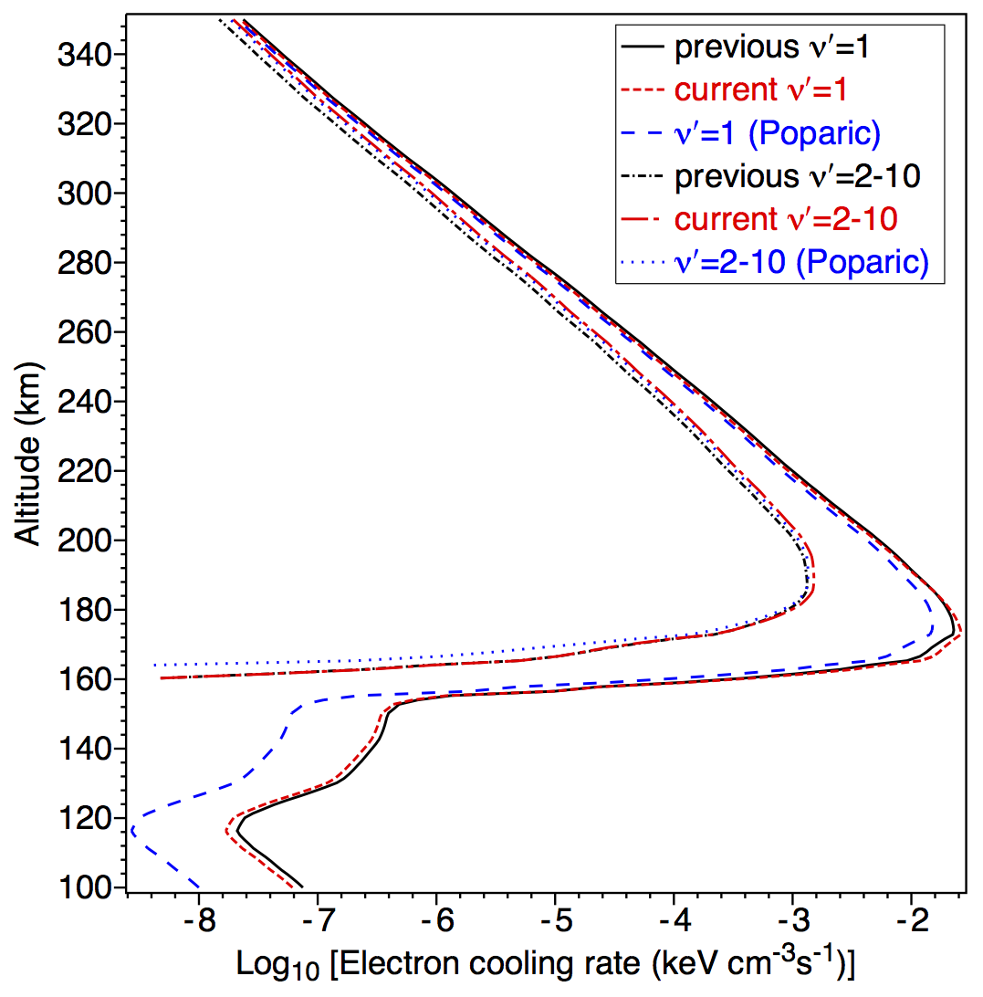
CO cooling rates - Mars
Calculated electron cooling rates by CO at Mars using cross sections of:
for 0 → ν′=1, ( ) Allan, 1989 (— —) Poparić et al., 2006 (- - - - - -) Allan, 2010
for sum of 0 → ν′=2,3,…,10, (-⋅-⋅-⋅-⋅-) Allan, 1989 (⋅ ⋅ ⋅ ⋅ ⋅ ) Poparić et al., 2006 ( ) Allan, 2010

