Slide 1
Atomic data for beam-stimulated
plasma spectroscopy in fusion plasmas
O. Marchuk¹, Yu. Ralchenko², D.R. Schultz³, W. Biel¹, T. Schlummer¹ and E. Stambulchik⁴
¹ - Institute of Energy and Climate Research, Forschungszentrum Jülich GmbH, 52425 Jülich, Germany
² - Quantum Measurement Division, National Institute of Standards and Technology, Gaithersburg, MD 20899, USA
³ - Department of Physics, University of North Texas, Denton, TX 76203, USA
⁴ - Weizmann Institute of Science, Rehovot, 76100, Israel
ICAMDATA-2012, NIST, Gaithersburg

Slide 2
Contents
Overview of the diagnostics based on the injection of fast atoms into the plasma
Why the available atomic data for beam emission can not be used ?
Calculation of the atomic data in the parabolic representation
Comparison with experimental data
Summary and Outlook
ICAMDATA-2012, NIST, Gaithersburg

Slide 3
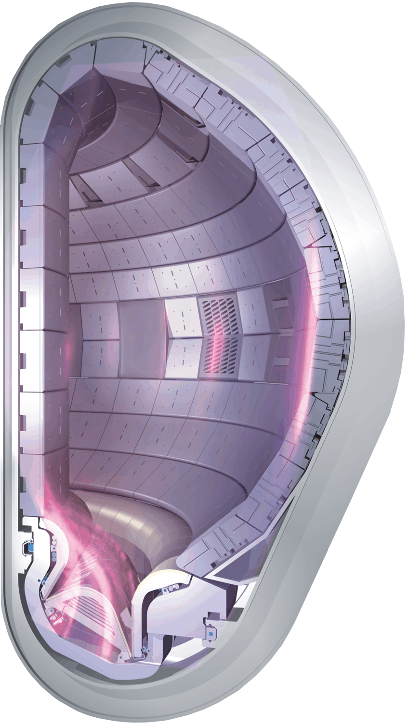
Plasma Parameters in Fusion
Plasma Temperature ~ 0.2 … 20 keV
Plasma Density ~10¹³…10¹⁴ cm⁻³
Magnetic Field ~1.. 7 T
In order to heat the plasma to these conditions
Injection of fast atoms into the plasma
Heating by the electromagnetic waves
Neutrals are also important
for the core plasma!
ICAMDATA-2012, NIST, Gaithersburg

Slide 4
Plasma Heating and Beams
Typical beam parameters (H, D)
Energy 30-1000 keV/u
ITER heating 500-870 keV/u
ITER diagnostic 100 keV/u
Current 30-60 A
Power < 60 MW
Positive ion source: 3 energy components
Negative ion source: 1 energy component
ICAMDATA-2012, NIST, Gaithersburg

Slide 5
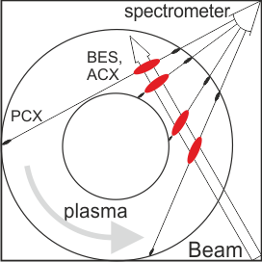
Diagnostics based on the injection of fast atoms
Range of plasma parameters:
Beam energy - 20.. 100 keV/u
Plasma temperature - 1..10 keV
Magnetic field – 1..7 T
BES – beam emission spectra
PCX – passive charge-exchange
ACX – active charge-exchange
H₀ + H⁺ → H∗ + H⁺→ ћω (1)
H₀ + X_{z+1} → H⁺ +X*_{z}(nl)→ ћω (2)
H_{α} spectroscopy on fast hydrogen atoms (BES)
source of charge-exchange diagnostic (CXRS)
ICAMDATA-2012, NIST, Gaithersburg

Slide 6
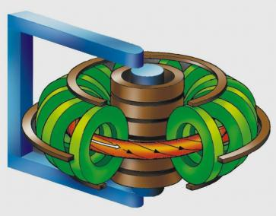
Fields „observed“ by fast atom
y
B
Lorentz transformation for the field:
y´
x
z
x´
$$\vec{F´}=\vec{F}+\frac{1}{c}\vec{v}×\vec{B}$$
$$\vec{B´}=\vec{B}−\frac{1}{c}\vec{v}×\vec{F}$$
z´
v
(cgs)
Beam atom
In the rest frame of the atom the bound electron experiences the effect of crossed magnetic $\vec{B´}$ and electric $\vec{F´}$ fields
(xyz) is the laboratory coordinate
system
(x´y´z´) is the coordinate system in the rest frame of hydrogen atom
Example: B = 1 T, E = 100 keV/u → v = 4.4·10⁸ cm/s → F = 44 kV/cm
Strong electric field in the rest frame of the atom is experienced by the bound electron
External fields are usually considered as perturbation applied to the field-free solution
ICAMDATA-2012, NIST, Gaithersburg

Slide 7
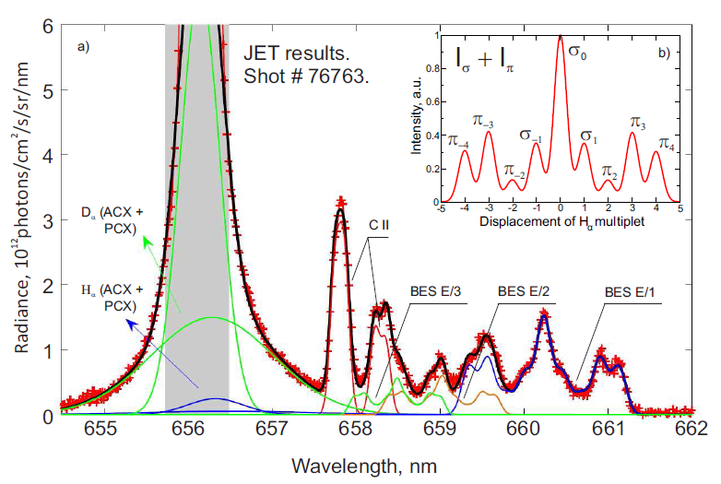
Beam-emission of fast atoms in the plasma
3 components in the beam (E/1, E/2, E/3)
Hα light from the edge
Emission of thermal H/D atoms
Cold components of CII Zeeman multiplet
Overlapped components of Stark effect spectra
Intensity of MSE (Motional Stark Effect) multiplet as a function of observation angle θ relative to the direction of electric field:
$$I\left(θ\right)={ΣI}_{π}\sin^{2}\left(θ\right)+{ΣI}_{σ}({1+cos}^{2}\left(θ\right))$$
ICAMDATA-2012, NIST, Gaithersburg

Slide 8
Linear Stark effect for the excited states
Hamiltonian is diagonal in parabolic quantum numbers
Spherical symmetry of the atom is replaced by the axial symmetry around the direction of electric field
Calculations of the line intensities, Schrödinger E (1926)
n k |m|
3 2 0
3 1 1
3 0 0
3-1 1
3-2 0
„Good“ quantum numbers:
n=n₁+n₂+|m|+1, n₁, n₂ >0 (nkm)
k=n₁-n₂ – electric quantum number
m – z-projection of magnetic moment:
z
n=3
σ₀
π₄
2 1 0
2 0 1
2 -1 0
n=2
$E\left(nkm\right)=−$1/2${·n}^{2}+3/2·F·n·k+O\left(F^{2}\right)$
σ
π
Example: $\sum{I_{π}}=\sum{Iσ}$; $Iσ1$/$Iσ$₀=0.353

Slide 9
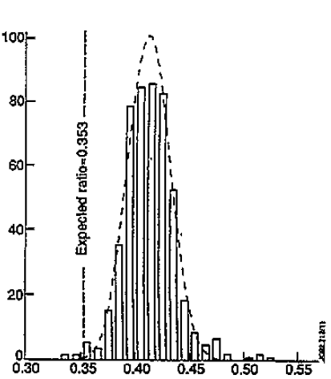
Problems with line intensities
$$I_{ij}=N_{i}×A_{ij,}$$
N_{i} is the population of the state i, A_{ij}-is the radiative rate, 1/s.
Statistical assumption:$\frac{N(a)}{N(b)}=\frac{g(a)}{g(b)}$
W. Mandl et al. PPCF 35 1373 (1993)
Statistical line intensities are not confirmed at JET and other devices
Plasma codes are based on the statistical assumption for the beam excited states (n=2, n=3,.. )
Number of events
$$R=\frac{\sum{Iπ}}{\sum{I_{σ}}}×\frac{\sin^{2}(θ)}{{1+cos}^{2}(θ)}$$
$Iσ1$/$Iσ$₀
ICAMDATA-2012, NIST, Gaithersburg

Slide 10
Major physical processes
Radiative decays
Well known (Bethe & Salpeter)
Field-induced ionization strong for high n’s
Electron-impact processes
Too high energies => small cross sections
Proton-impact processes
The strongest but…
Problem: no cross sections/rate coefficients
for transitions between parabolic states
ICAMDATA-2012, NIST, Gaithersburg

Slide 11
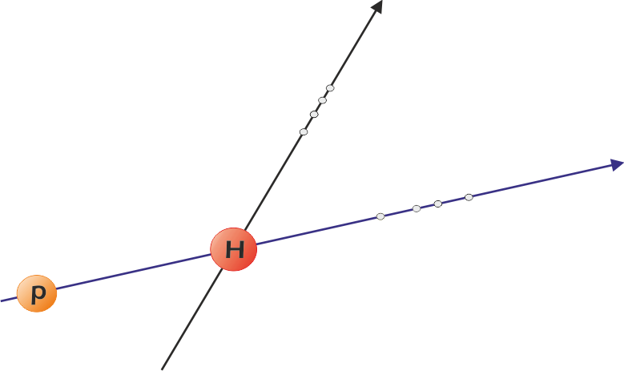
Cross sections in parabolic states
$$\vec{F}(z)$$
$$\vec{F}=\vec{v}×\vec{B}$$
parabolic states n_{i}k_{i}m_{i}
$$\vec{v}(z′)$$
θ
n_{i}l_{i}m_{i} – spherical states
θ=π/2 for MSE
Calculations include two transformations of wavefunctions
Rotation of the collisional (z‘) frame on the angle θ to match z frame Edmonds A R 1957 Angular Momentum in Quantum Mechanics (Princeton, NJ: Princeton University Press)
Transformation between the spherical and parabolic states in the same frame z Landau L D and Lifshitz E M 1976 Quantum Mechanics: Non-Relativistic Theory
ICAMDATA-2012, NIST, Gaithersburg

Slide 12
Calculation of the cross sections in parabolic states
The expression for the cross section can be written as:
Density-matrix elements
$$σ_{2±10}=\frac{1}{2}σ_{2s0}+\frac{1}{2}\cos^{2}\left(θ\right)σ_{2p0}+\frac{1}{2}\sin^{2}\left(θ\right)σ_{2p1}∓\cos\left(θ\right)Re({ρ_{s0}^{}}^{p0})$$
cross sections (diagonal elemens)
coherence terms
(off-diagonal elements)
ICAMDATA-2012, NIST, Gaithersburg

Slide 13
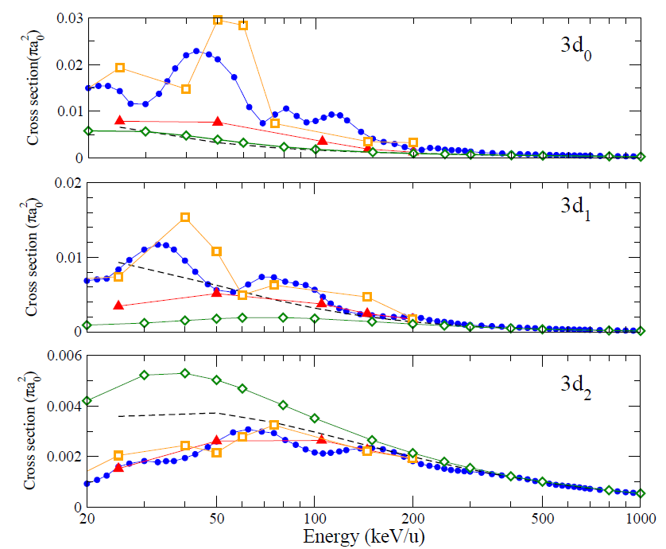
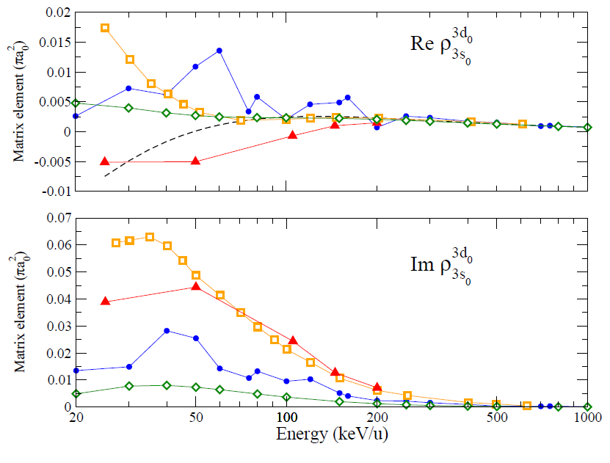
Calculation of the cross sections in parabolic states (n=3)
Close-coupling calculations
Glauber approximation
Eikonal approximation
Born approximation
ICAMDATA-2012, NIST, Gaithersburg

Slide 14
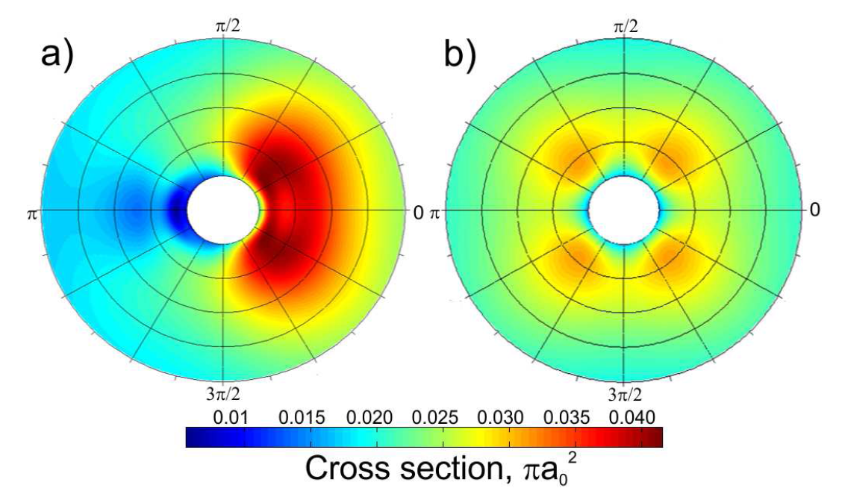
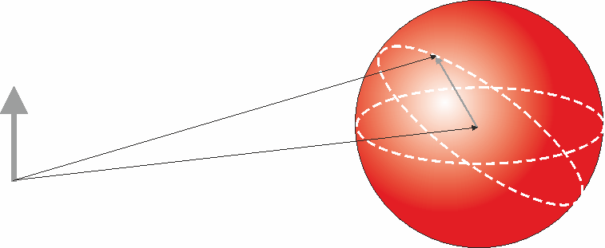
Influence of the orientation on the cross sections
Energy is varied in radial direction : 20…200 keV/u
Polar angle is the angle between the field direction and the projectile. (MSE–$π$/2)
(3,1,1)
$\vec{F}=\vec{v}×\vec{B}$ ?
Why do we need the angular dependence if
Cross section depends on the relative velocity between beam and plasma particles.
F
relative velocity $\vec{u}$
-${\vec{v}}_{p}$
The formulas for rate coefficients beam-Maxwellian plasma must include the angular dependence.
π/2
Beam direction $\vec{v}$
ICAMDATA-2012, NIST, Gaithersburg

Slide 15
Effect of the orientation on the Hα Stark multiplet emission
F
statistical calculations
θ
v
The strongest deviation to the statistical case is observed for the conditions of Stark effect
Increase of π and drop of σ components as a function of angle θ is observed
ICAMDATA-2012, NIST, Gaithersburg

Slide 16
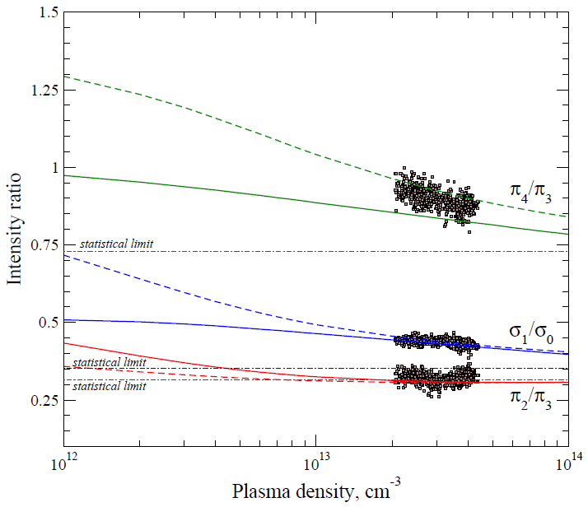
Lines ratio of H_{α} Stark multiplet
Statistics:
Collisions >> Radiation
n=3
Δn=0
Collisions
Radiation
n=1
O. Marchuk et al. JPB 43 011002 (2010) /theoretical results; dashed- Glauber approximation
solid- close-coupling (AOCC) + Glauber approximation/
E. Delabie et al. PPCF 52 125008 (2010) /new experimental data/
ICAMDATA-2012, NIST, Gaithersburg

Slide 17
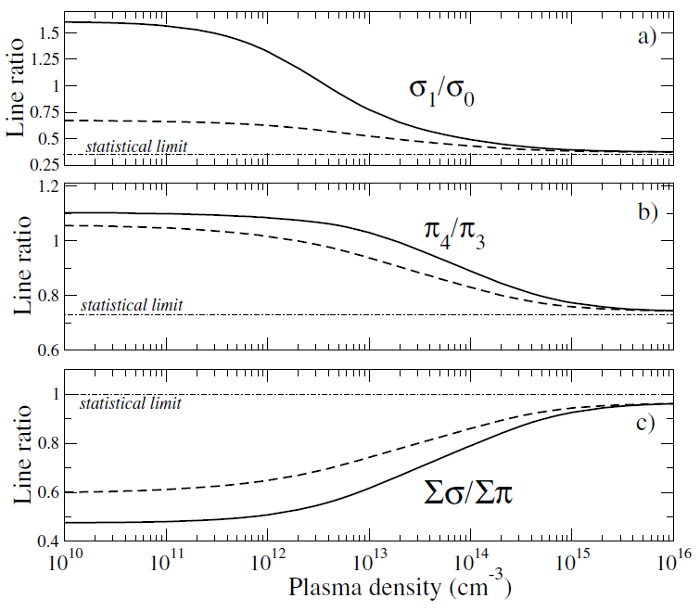
Calculations in strong magnetic field
Plasma parameters:
Magnetic field- 5T
Plasma temperature 20 keV Beam energy:
solid line – 500 keV/u dashed line – 100 keV/u
The non-statistical populations influence the Stark effect spectra → Reduction of σ -lines emission
ICAMDATA-2012, NIST, Gaithersburg

Slide 18
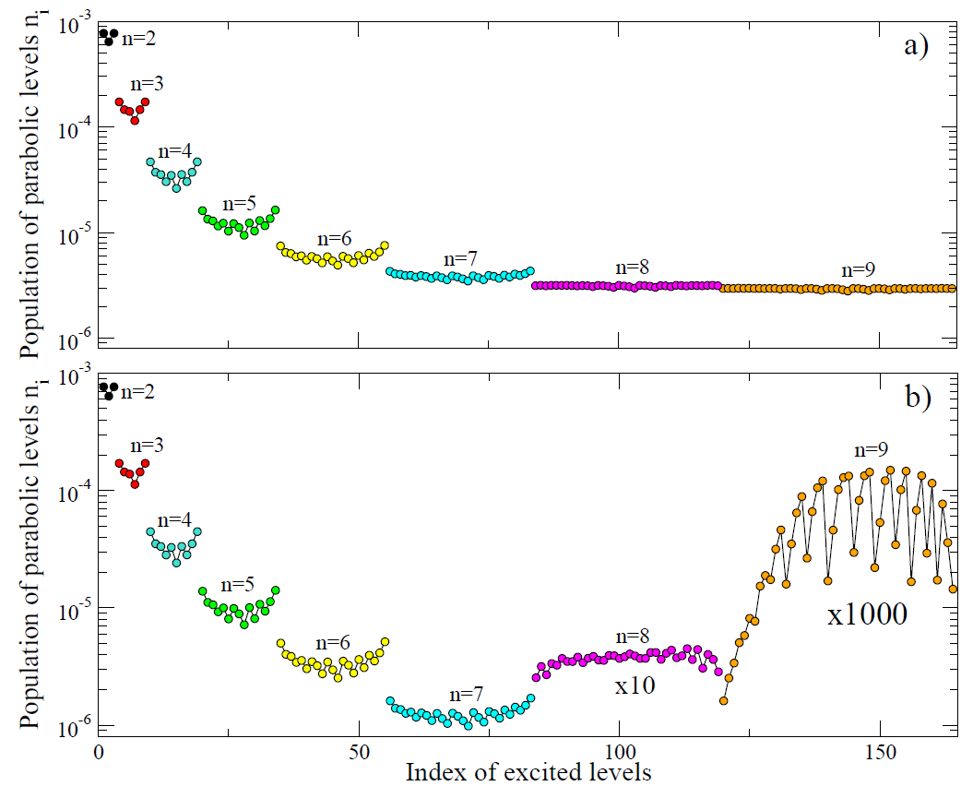
Populations of parabolic Stark levels
Beam energy 50 keV/u
Plasma density 3·10¹³ cm⁻³
Magnetic field is 3 T
Field ionization is excluded
Field ionization is included
ICAMDATA-2012, NIST, Gaithersburg

Slide 19
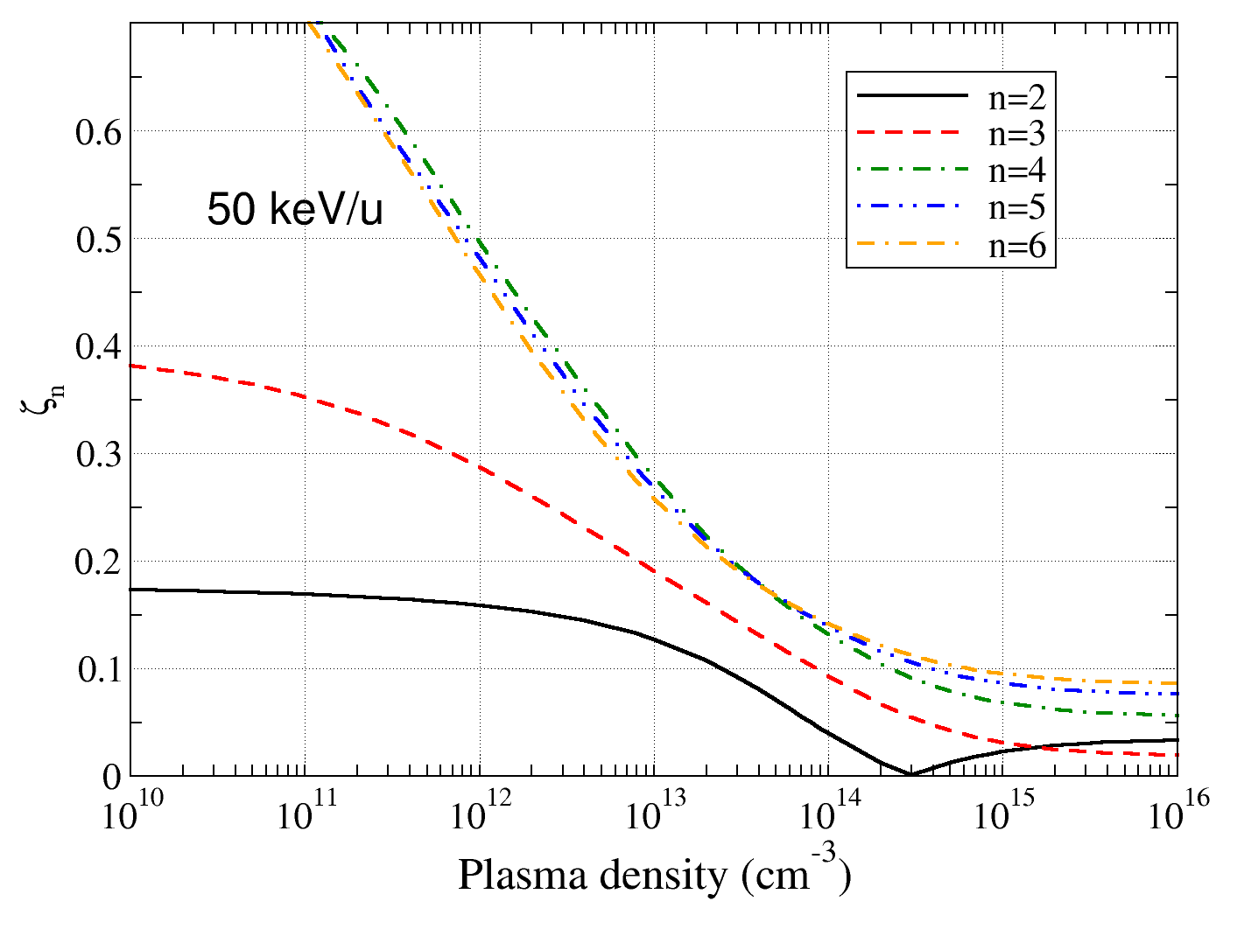
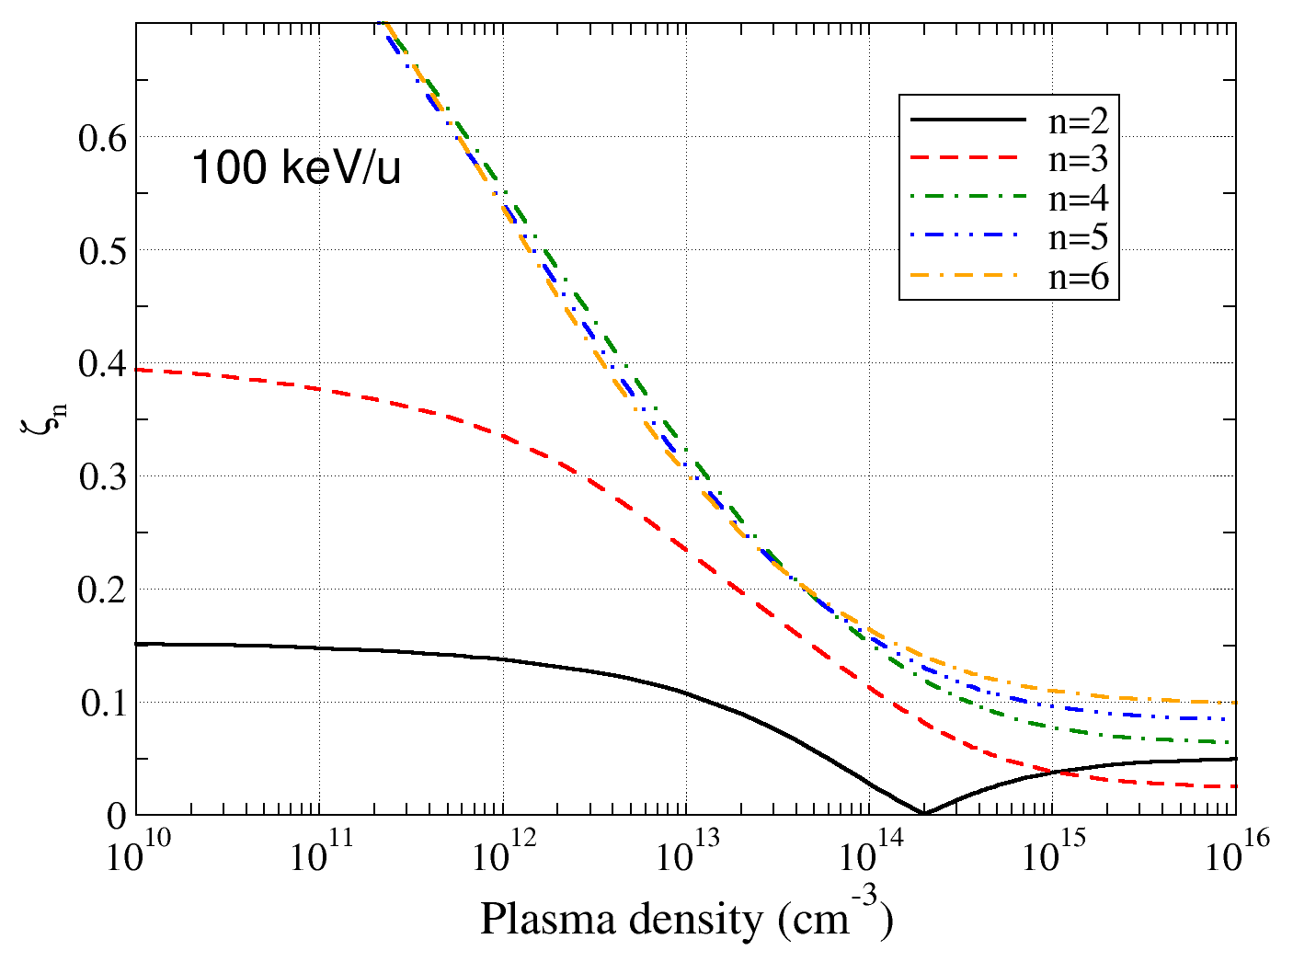
Deviation from statistical distribution
Does not reach
statistical limit,
primarily due
to collisional
ionization
ICAMDATA-2012, NIST, Gaithersburg
O Marchuk, Yu. Ralchenko and D R Schultz PPCF 54 095010 (2012)

Slide 20
Summary and Outlook
The experimental beam-emission spectra demonstrate a significant deviation for the σ- and π- lines ratios for the Hα line from the statistical values
CRM model in parabolic states completely resolved up to n=10 taking into account field ionization is developed without any assumption on the statistical equilibrium
Density matrix elements for heavy particles collisions play in this model the major role
The theoretical data are still extremely rare
ICAMDATA-2012, NIST, Gaithersburg

Slide 21
The comparison with the experimental data in the Glauber and AOCC demonstrates a very good agreement with JET data.
The populations of the excited levels of the beam do not follow the statistical assumption
The reduction of the σ- to the π- components in the emission of the spectral lines is observed.
Comparison of the simulations with experimental data from other fusion devices is now ongoing
ICAMDATA-2012, NIST, Gaithersburg

Slide 23
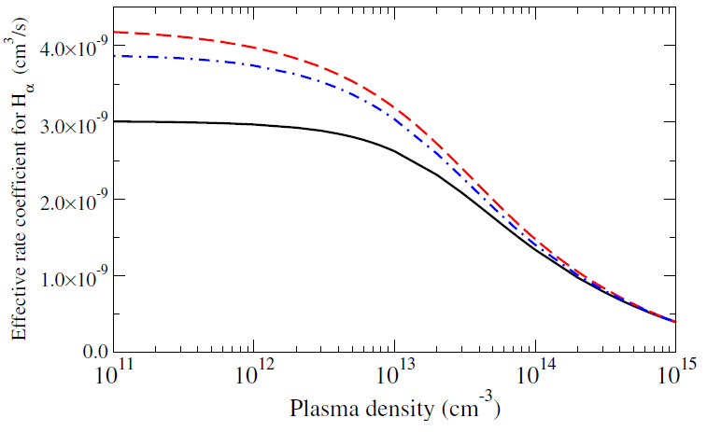
Reduction of beam-emission rate
Measurements of CXRS impurity lines at ITER:
$$I_{z}\left(x\right)=C×N_{z+1}^{}(x)\sum_{i}{N_{b}^{i}}(x){∙Q}_{eff}^{cx, i}(x)$$
$$N_{z+1}\left(x\right)\sim \frac{Q_{eff}^{BES,i}}{Q_{eff}^{cx,i} }$$
$$I_{BES}(x)={C×N}_{e}^{}(x)\sum_{i}{N_{b}^{i}}(x){∙Q}_{eff}^{BES,i}(x)$$
Calculations
black line – present model
blue line – present model with infinite collisional rate within Δn=0 transitions
red line – statistical model O. Marchuk et al. Rev. Sci. Instrum. 79 10F532 (2008)*
*- discussion on agreement between statistical models, Delabie E. et al., PPCF 52 125008 (2010)

Slide 24
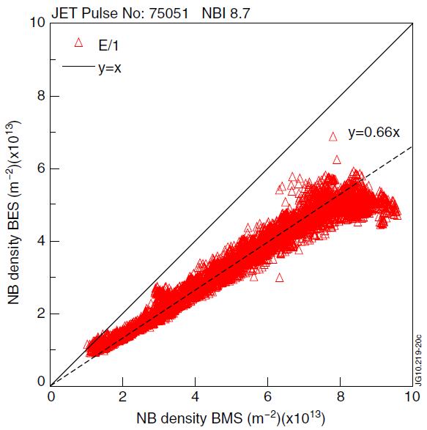
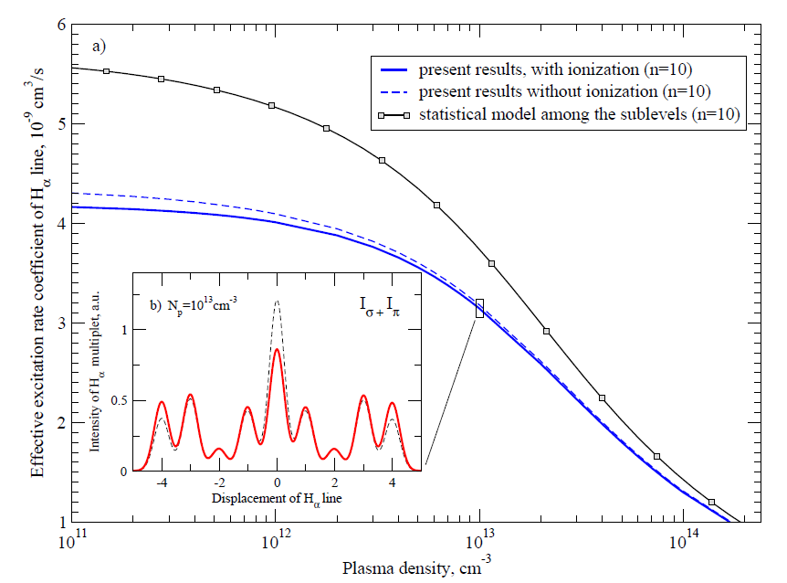
Reduction of the beam emission rate coefficients
Observation of long-standing discrepancy on the order of 20-30% between the measured (BES) and calculated density of hydrogen beam in the plasma using statistical models
The non-statistical simulations demonstrate a reduction of the beam emission rate relative to the statistical model on the order of 15-30% at low and intermediate density.
E=100 keV/u
T=3 keV

Slide 25
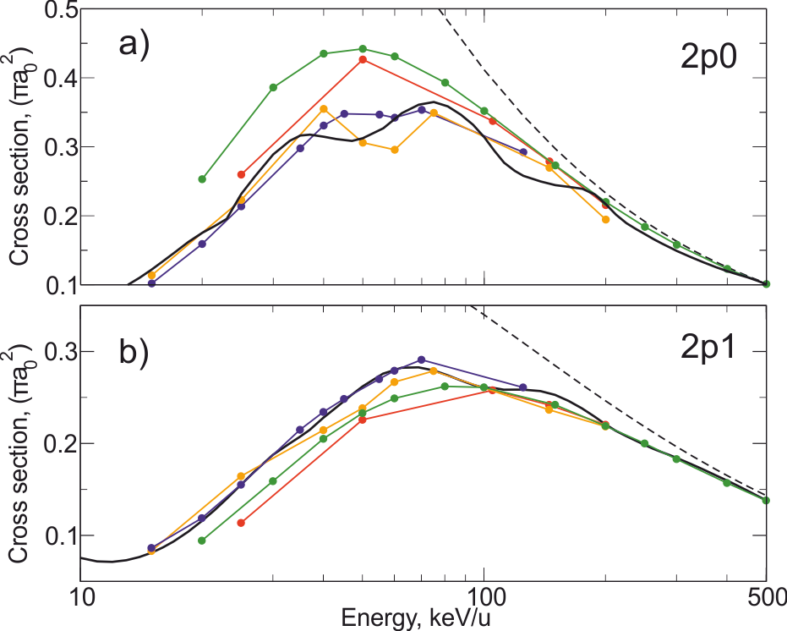
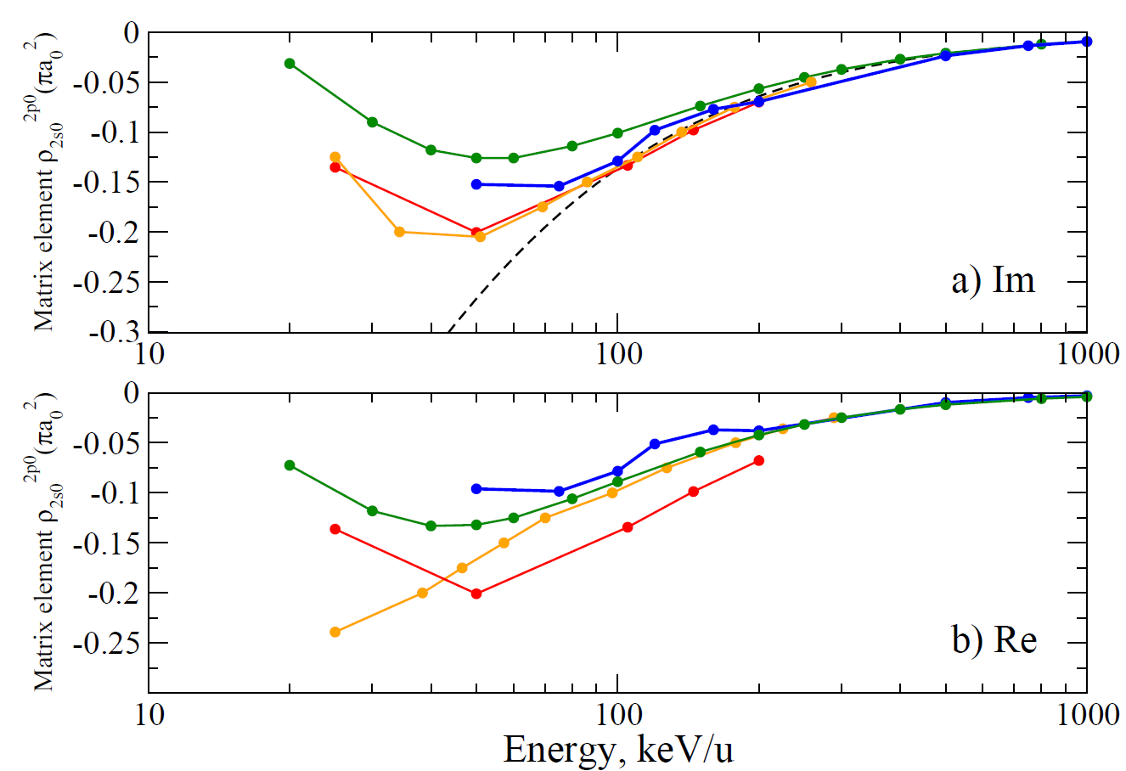
Calculation of the cross sections in parabolic states (n=2)
s-p
s-p
black - AOCC (present results)
green – Glauber approximation (present results)
dashed - Born approximation
blue - SAOCC Winter TG, Phys. Rev. A 2009 80 032701
orange - SAOCC Shakeshaft R Phys. Rev. A 1976 18 1930
red – eikonal approximation, Rodriguez VD and Miraglia JE J. Phys. B: At. Mol. Opt. Phys. 1992 25 2037
blue - AOCC (present results)
green - Glauber approximation (present results)
dashed - Born approximation
orange - CCC Schöller O et al. J. Phys B.: At. Mol. Opt. Phys. 19 2505 (1986)
red – eikonal approximation, Rodriguez VD and Miraglia JE J. Phys. B: At. Mol. Opt. Phys. 1992 25 2037
ICAMDATA-2012, NIST, Gaithersburg

